Slide 1
EDUCATION IN THE 21ST CENTURY:
BUILDING A COMMON DESTINY
Luis Ricardo Fraga
University of Washington
University of North Texas
Denton, TX
February 27, 2013

Slide 2
Education in the 21st Century
How has the growth in the Latino population affected discourse in the Department of Education and the White House regarding postsecondary education and the future of the nation?
What higher education policy initiatives can we pursue at national and state levels to leverage the greatest increases in postsecondary completion for all students?

Slide 3
Latinos in the Future of the United States

Slide 4
Source: U.S. Bureau of the Census, 1981,1991, 2002, 2008

Slide 5
62.6% of all Latinos in the U.S. are U.S. born
47.3% of all Latinos over 18 years of age are U.S. born
91.7% of all Latinos under 18 years of age are U.S. born
Source: Suro & Passel, Pew Hispanic Center (2003); Pew (2009)

Slide 6
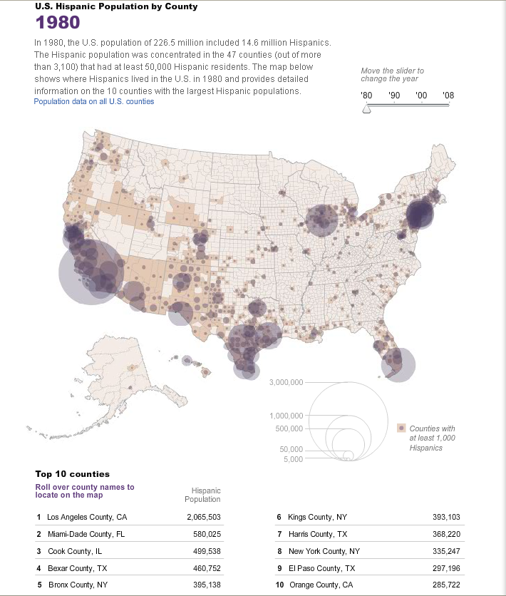

Slide 7
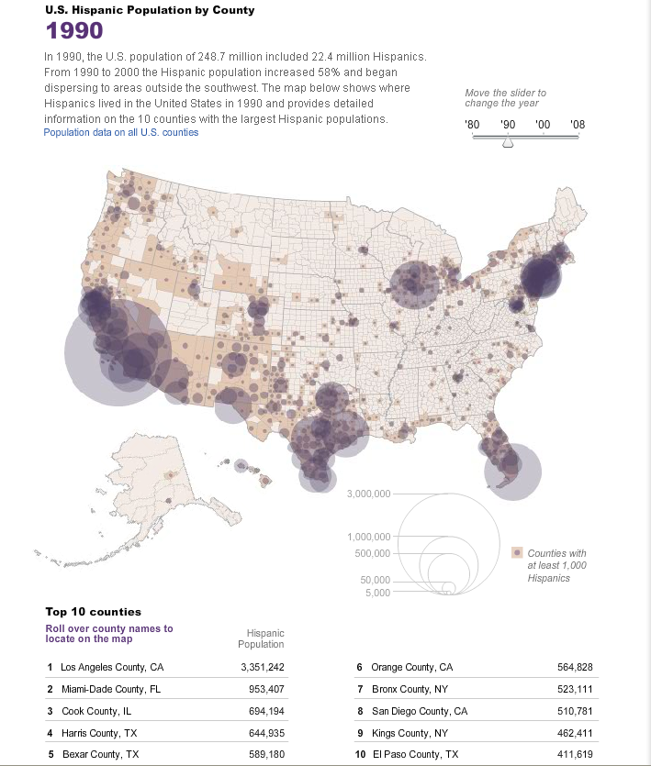

Slide 8
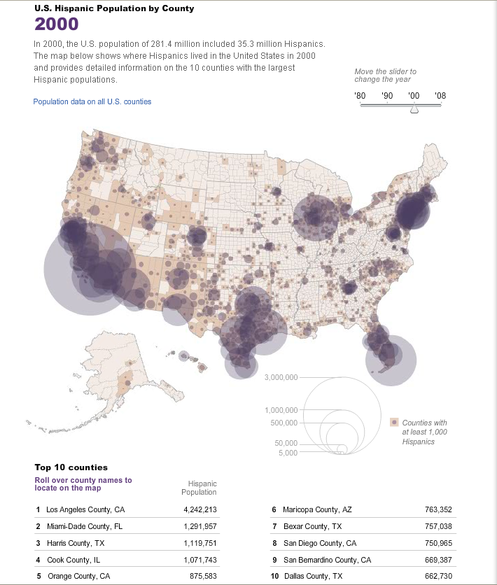

Slide 9
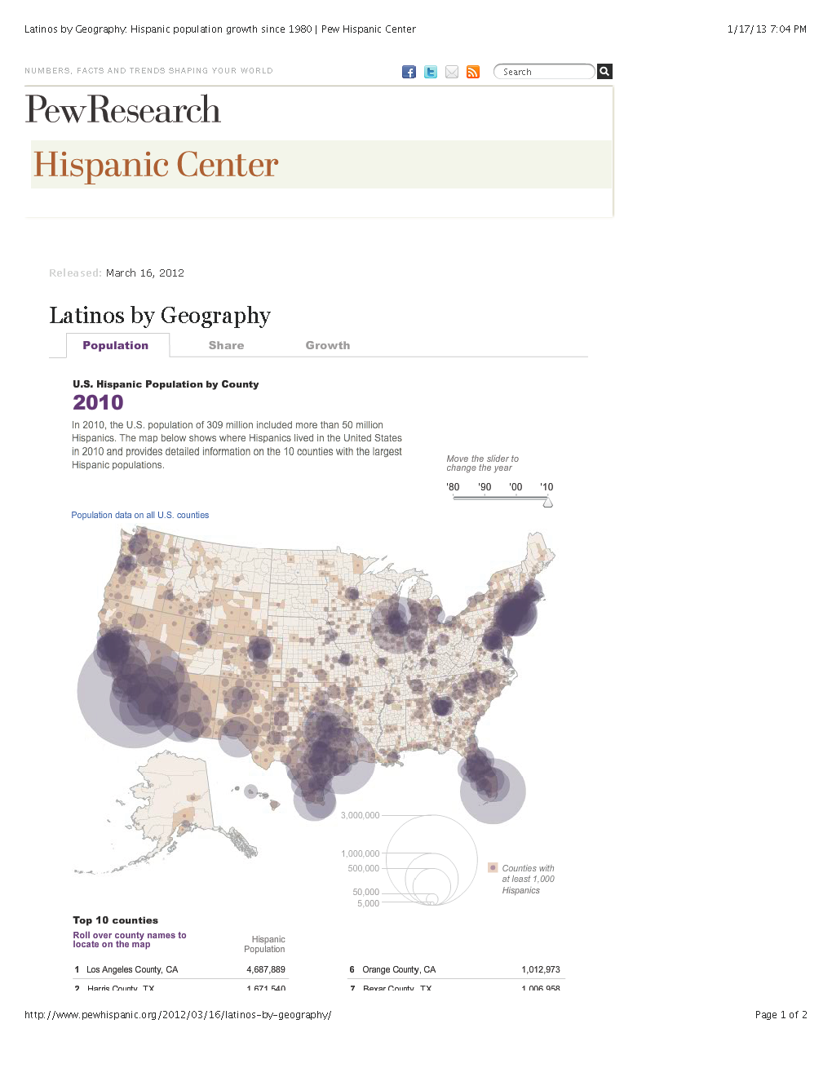

Slide 10
Growth of Enrollment in Public Schools
Source: Pew Hispanic Center 2006

Slide 11
Growth in Latino Public School Enrollment
Source: Pew Hispanic Center 2006

Slide 12
Building a Common Destiny: Increasing Latino Educational Attainment

Slide 13
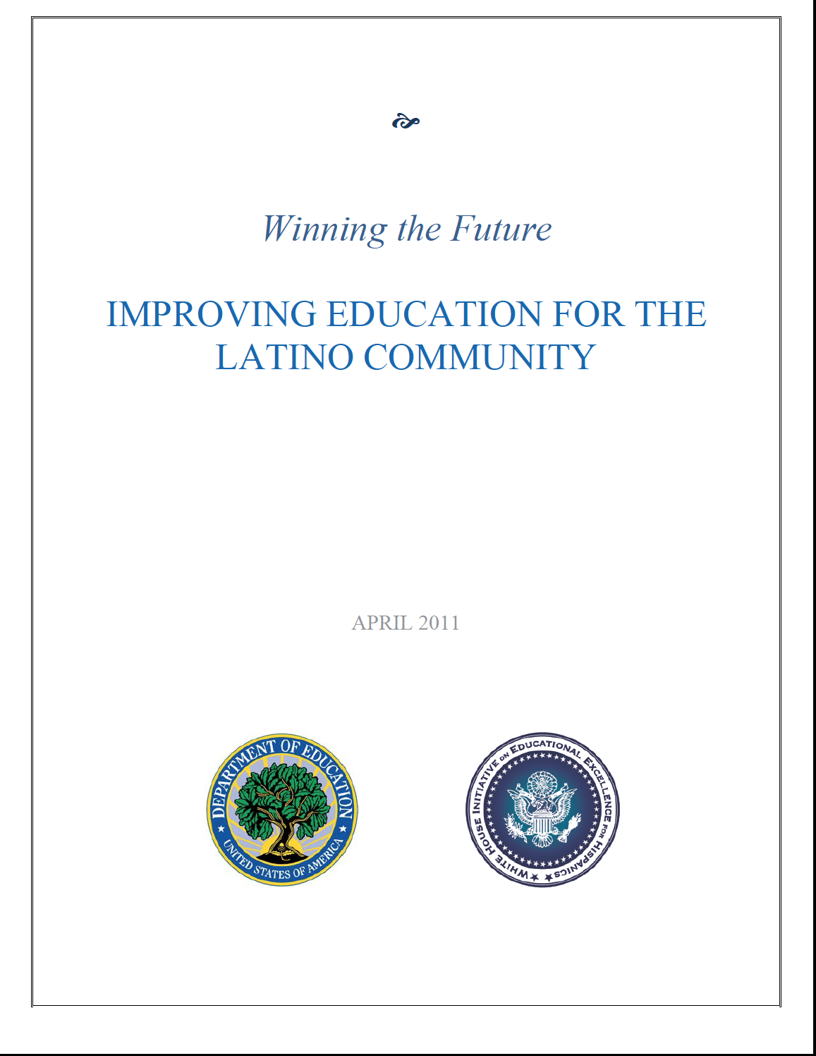

Slide 14


Slide 15
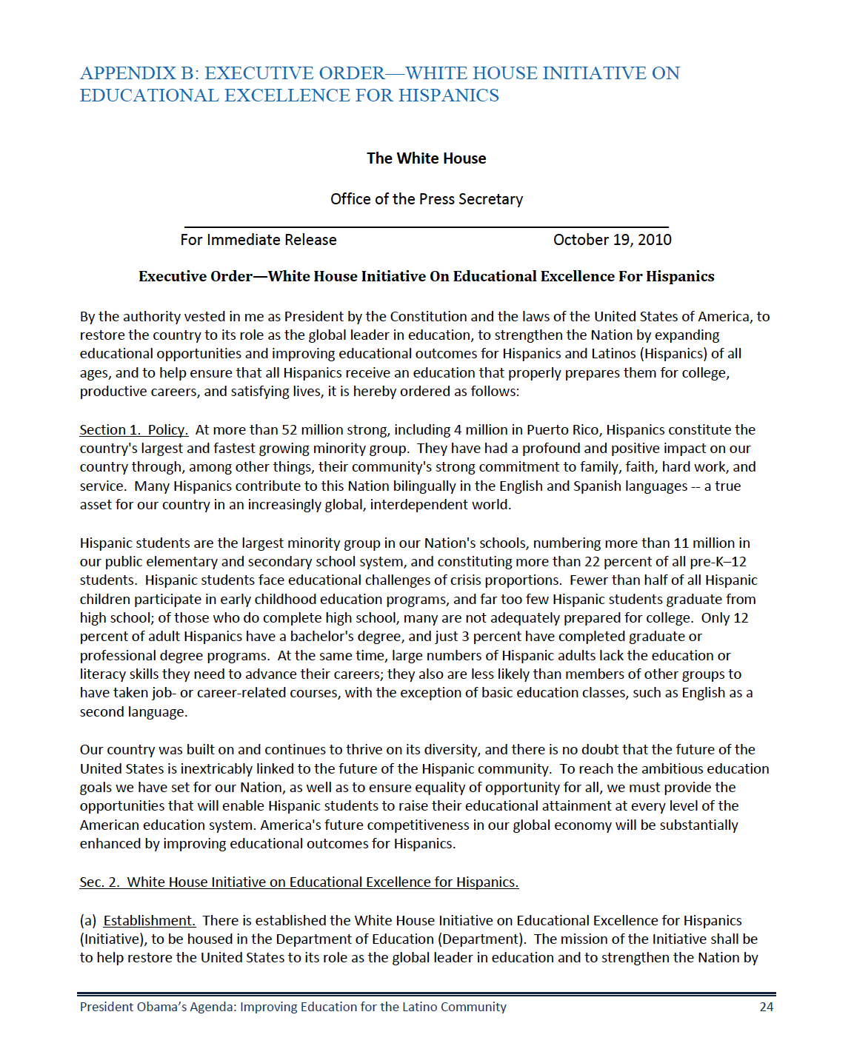

Slide 16
The State of Latino Postsecondary Education

Slide 17
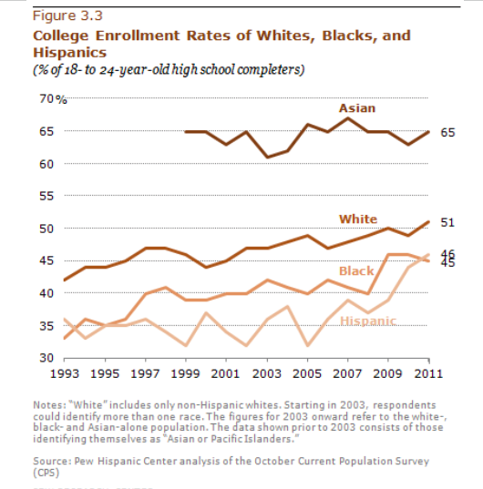

Slide 18
Table A-39-1. Number and percentage distribution of fall undergraduate enrollment in degree-granting institutions, by control and level of institution and selected student characteristics: Fall 2009
 | Public 2-Year | Private not-for-profit, 2-Year | Private for-profit, 2-Year | Public 4-Year | Private not-for-profit, 4-Year | Private for-profit, 4-Year
White | 38.3% | 0.2% | 1.6% | 37.9% | 16.2% | 5.8%
Black | 40.4% | 0.3% | 4.1% | 29.7% | 12.8% | 12.8%
Hispanic | 51.8% | 0.1% | 3.5% | 29.7% | 8.2% | 6.6%
Asian/Pacific Islander | 41.9% | 0.2% | 1.4% | 39.5% | 13.3% | 3.8%
American Indian | 44.9% | 0.7% | 2.0% | 35.0% | 9.9% | 7.4%
Nonresident Alien | 25.6% | 0.2% | 0.6% | 43.8% | 25.0% | 4.7%
Source: U.S. Department of Education, National Center for Education Statistics, 2009 Integrated Postsecondary Education Data System (IPEDS), Spring 2010, Fall Enrollment

Slide 19
Completion at Two-year Institutions (150%), Cohort 2005
Source: U.S. Department of Education, National Center for Education Statistics, Integrated Postsecondary Education Data System (IPEDS), Spring 2003 and Spring 2009, Graduation Rates component

Slide 20
Completion at Four-year Institutions (6 yrs.), Cohort 2002
Source: U.S. Department of Education, National Center for Education Statistics, Integrated Postsecondary Education Data System (IPEDS), Spring 2003 and Spring 2009 Graduation Rates component

Slide 21
Higher Education Policy Initiatives:
Leveraging National and State Efforts

Slide 22
Enriching America Through the 21st Century: Increasing Latino Postsecondary Completion
Financing Higher Education
  Continue to improve FAFSA
  Increase work study and link to careers, e.g., STEM
  Restore Pell grant eligibility from 12 to 18 semesters
Enhancing Academic Competence
  Review current math and English placement exams
  Fund 2-yr and 4-yr institutional partnerships
  Establish regional developmental education centers
Empowering Latino Families
  Provide annual tax deduction when living at home
  Develop post-sec information inventory
  Develop competitive initiative on engaging families

Slide 23
Building a Common Destiny: Increasing Latino Postsecondary Completion

Slide 24
Parent Aspiration of Child’s Education
Question: How far would you like to see this child go in school?
Source: Latino National Survey, 2006

Slide 25
Parent Expectation of Child’s Education
Question: How far do you think your child will go in school?
Source: Latino National Survey, 2006

Slide 26
Children Living in Poverty, 2008
Category Number Percent
All under 18 15,451,000 20.7
White 4,850,000 11.9
African American 4,480,000 35.4
Hispanic 5,610,000 33.1
Source: U.S. Bureau of the Census (2009)

Slide 27
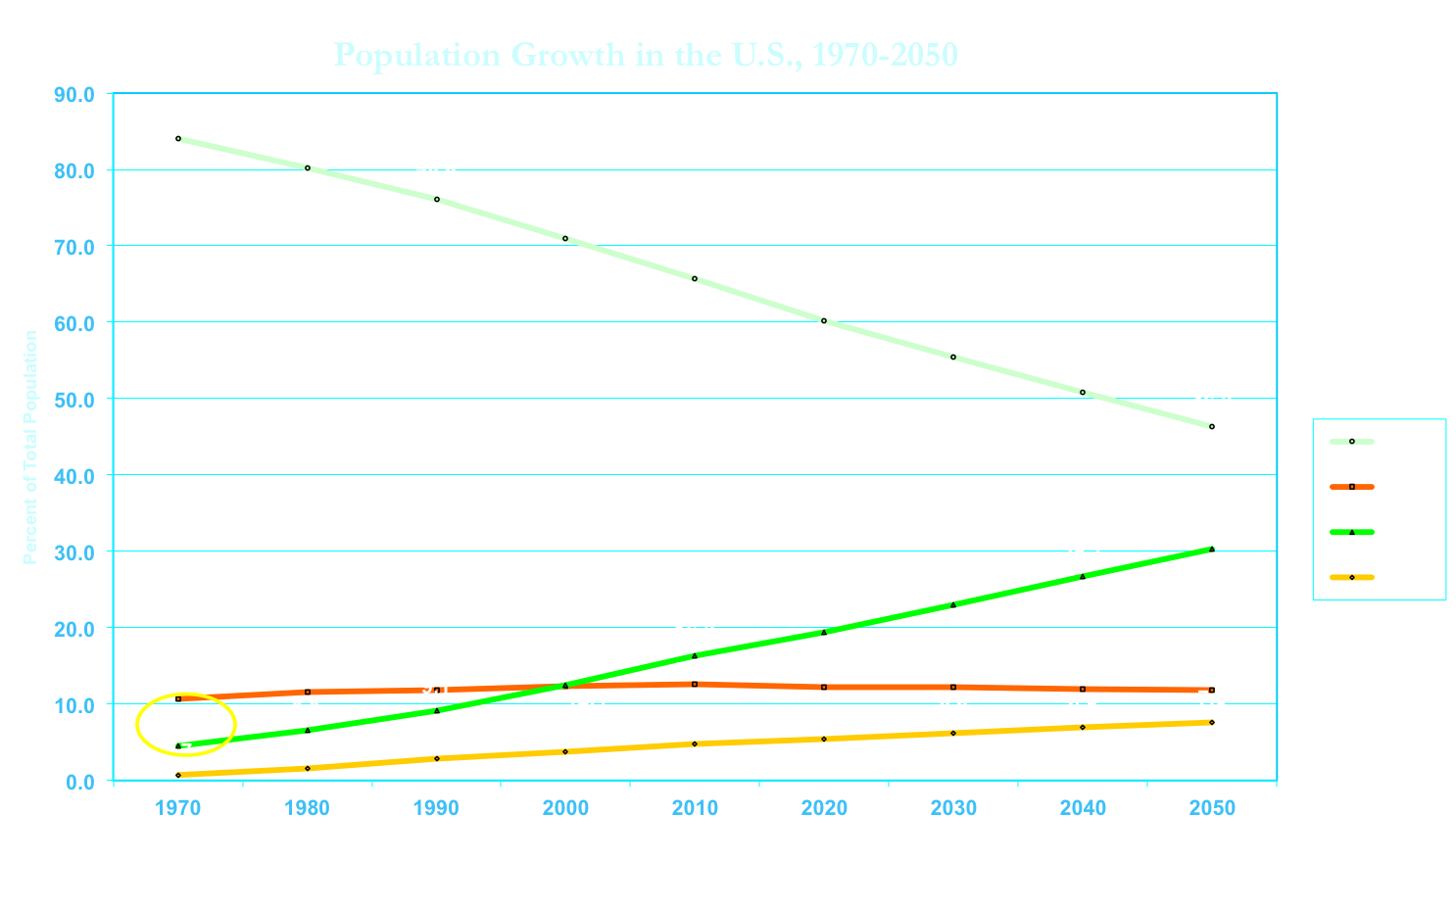
Source: U.S. Bureau of the Census, 1981,1991, 2002, 2008

Slide 28
“To understand your country you must love it. To love it you must, in a sense, accept it. To accept it as it is, however, is to betray it. To accept your country without betraying it, you must love it for that in it which shows what it might become.”
Unger and West (1998)

Slide 29
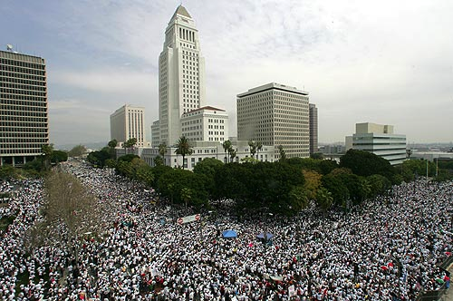
Los Angeles 2006

