Slide 1
Building an Inclusive Faculty: Stakeholders, Standards, and Strategies
Luis Ricardo Fraga
Associate Vice Provost for Faculty Advancement
Russell F. Stark University Professor
Director, Diversity Research Institute
Professor, Department of Political Science
University of Washington
University of North Texas
Denton, TX
November 29, 2012

Slide 2
Inclusion and Diversity
Inclusion is indispensable to excellence
Expanding organizational capacity
Placing inclusion central to the mission of the institution
Innovation is necessary for progress
Past practices are not sufficient
Past insights are limited

Slide 3
Tenure/Tenure-Track Faculty, Fall 2011

Slide 4
Change in Total Tenured and Tenure-Track Faculty, 1997-2010

Slide 5
Gender Distribution of New Faculty Hires, 2001-2010

Slide 6
Ethnic Distribution of New Faculty Hires, 2000-2010

Slide 7
Achieving and Maintaining Faculty Diversity
Commitment: Building Expectations
Overcoming disempowerment
Learning from failure and overcoming risk aversion
Working collaboratively with key gatekeepers
Process: outreach, criteria of assessment, accountability
Climate: Enriching the work environment
Institutional: highest level leadership
Departmental: the key to long-term success
Surveys, focus groups, reassessment
Mentorship: Empowering faculty to make informed decisions
Individual and group
Establishing full transparency
Providing opportunities for upward mobility
Research and Teaching: Building excellence
Intellectual communities of interest and support
Valuing the intellectual contributions that promote institutional change

Slide 8
Practices and Strategies
Public support of the President, Provost, Deans,
and Department Chairs
Unambiguous signaling
Building consensus among senior leadership
“Inclusion is indispensable to excellence”

Slide 9
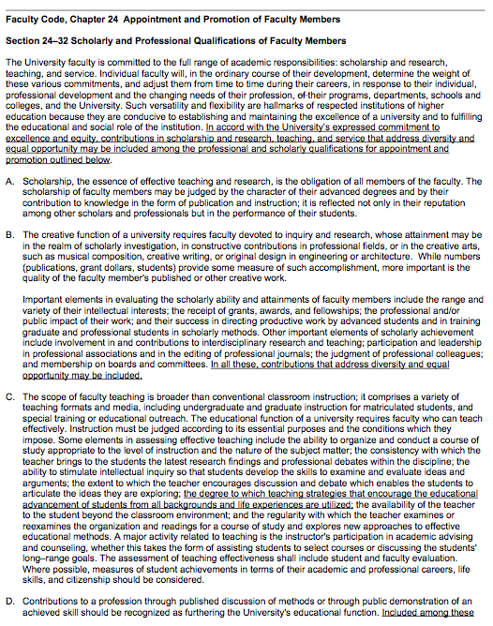
Faculty Code Ch. 24 Appointment and Promotion of Faculty Members Page 1

Slide 10
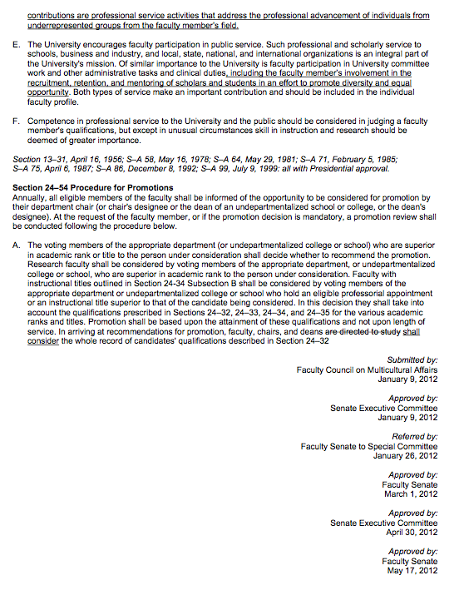
Faculty Code Ch. 24 Appointment and Promotion of Faculty Members Page 2

Slide 12
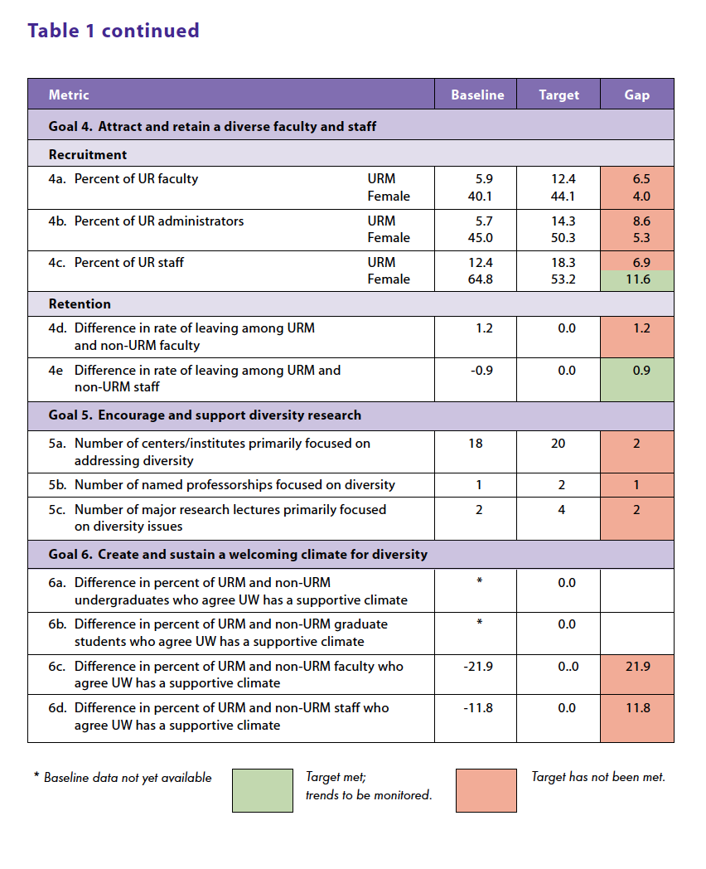

Slide 13
Practice and Strategies
Public support of the Dean and Dept. Chair
Unambiguous signaling
Building consensus among senior leadership
“Inclusion is indispensable to excellence”
Advertising the position
Include diverse populations in the merit requirements for the position
Requesting a diversity statement from the candidates
Mobilizing professional networks of current faculty

Slide 14
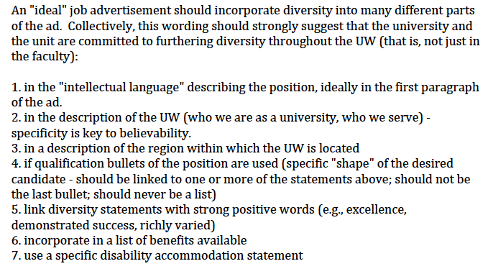
Julia K. Parrish, Associate Dean for Academic Affairs and Diversity,
College of the Environment, University of Washington

Slide 15
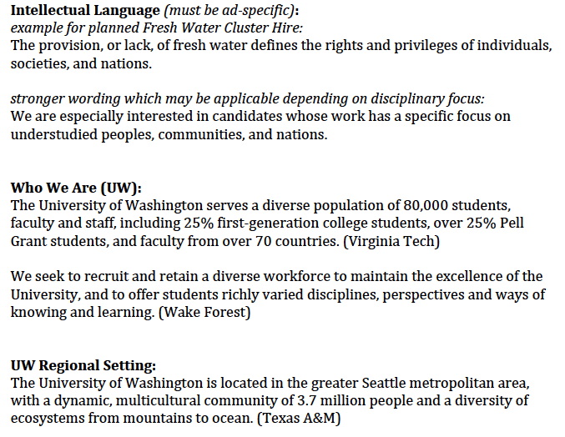

Slide 16
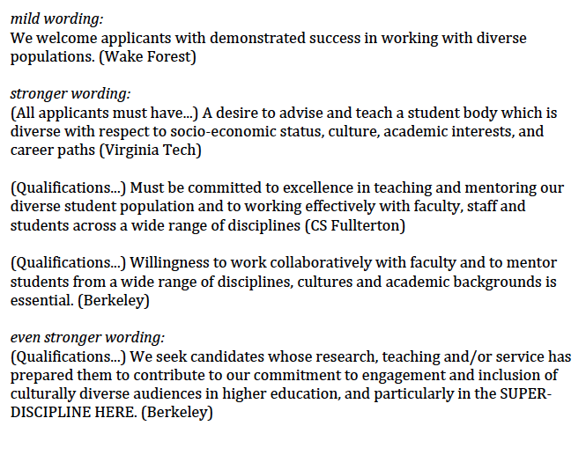

Slide 17
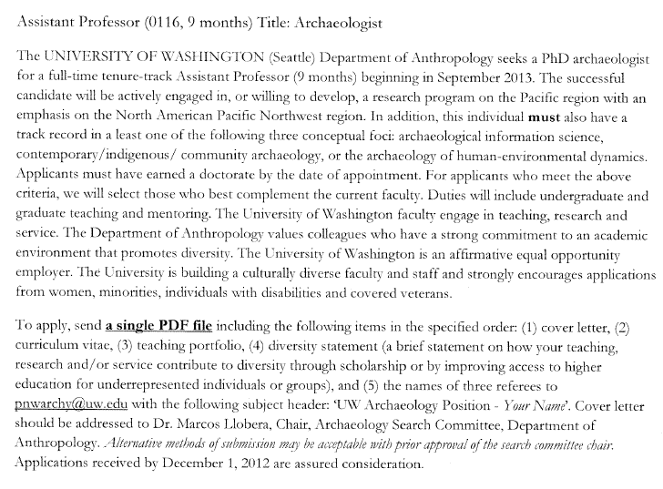

Slide 18
Practices and Strategies
Evaluating Candidates
Using an inclusive matrix of criteria
Limiting unconscious bias
Valuing inclusion as an intentional strategy

Slide 19
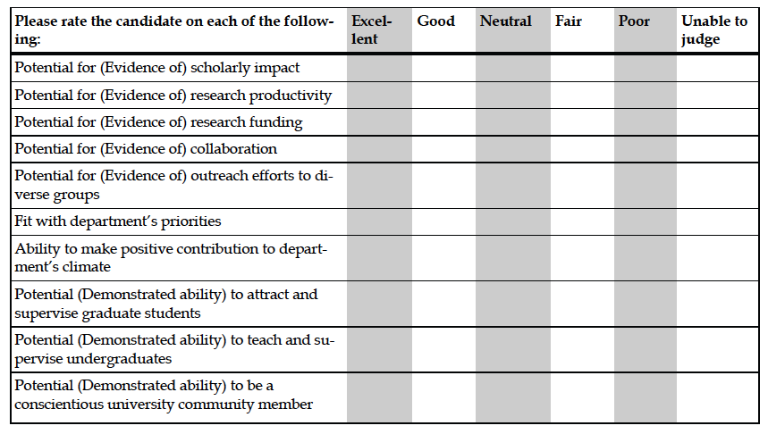
UCLA and University of Michigan, 2012

Slide 20
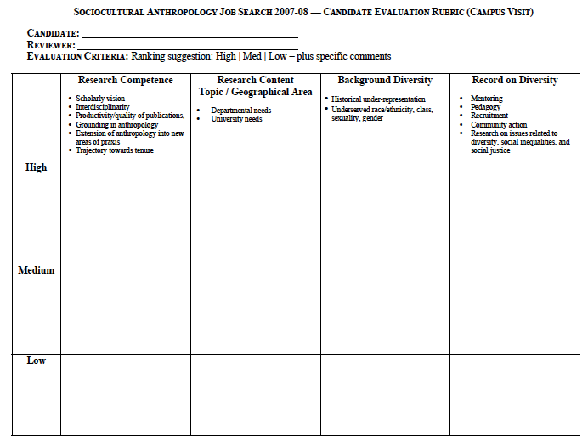

Slide 21
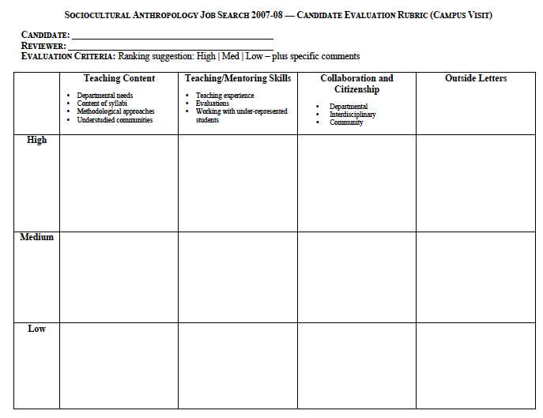

Slide 22
Implicit Association and Unconscious Bias
https://implicit.harvard.edu/implicit/demo/

Slide 23
Practice and Strategies
Evaluating Candidates
Using an inclusive matrix of criteria
Limiting unconscious bias
Valuing inclusion as an intentional strategy
Ensuring success, promotion, tenure
Cluster hiring
Climate surveys
Mentoring
Providing opportunities for upward mobility

Slide 24
Resources
Faculty Recruitment Toolkit
http://www.washington.edu/diversity/avpfa/toolkit/index.shtml
Research Bibliography
http://www.washington.edu/diversity/avpfa/resources.shtml
Office for Faculty Advancement
http://www.washington.edu/diversity/avpfa/index.shtml

Slide 25
Contact Information
Office for Faculty Advancement
Luis Ricardo Fraga, Associate Vice Provost for Faculty Advancement
lrfraga@uw.edu
206.685.4831
Norma E. Rodriguez, Director
normar@uw.edu
206.543.9833
www.washington.edu/diversity/avpfa
Diversity Research Institute
www.washington.edu/diversity/dri

Slide 27
University-Wide Profile of Tenured and Tenure-Track Faculty, 1997-2011
Year | Total | White Female | White Male | Black Female | Black Male | Asian Female | Asian Male | Latino Female | Latino Male | American Indian Female | American Indian Male
1997 | 1817 | 387 | 1234 | 14 | 26 | 29 | 84 | 9 | 29 | 2 | 3
1998 | 1848 | 424 | 1212 | 17 | 30 | 29 | 89 | 11 | 31 | 2 | 3
1999 | 1897 | 453 | 1203 | 22 | 32 | 38 | 98 | 11 | 34 | 3 | 3
2000 | 1917 | 461 | 1203 | 23 | 32 | 43 | 105 | 9 | 35 | 4 | 2
2001 | 1923 | 485 | 1175 | 20 | 31 | 54 | 107 | 9 | 35 | 4 | 3
2002 | 1940 | 503 | 1161 | 20 | 31 | 54 | 116 | 10 | 36 | 6 | 3
2003 | 1942 | 508 | 1154 | 21 | 28 | 55 | 119 | 11 | 38 | 5 | 3
2004 | 1956 | 503 | 1152 | 23 | 28 | 61 | 123 | 13 | 40 | 8 | 5
2005 | 1991 | 528 | 1145 | 27 | 24 | 69 | 131 | 11 | 43 | 8 | 5
2006 | 2026 | 543 | 1147 | 27 | 25 | 77 | 135 | 13 | 47 | 8 | 4
2007 | 2037 | 571 | 1127 | 26 | 23 | 78 | 134 | 18 | 47 | 9 | 4
2008 | 2060 | 565 | 1109 | 30 | 26 | 82 | 158 | 22 | 56 | 8 | 4
2009 | 2107 | 571 | 1127 | 29 | 26 | 89 | 149 | 23 | 59 | 6 | 2
2010 | 2070 | 569 | 1080 | 30 | 22 | 89 | 159 | 24 | 61 | 7 | 2
2011 | 2050 | 587 | 1028 | 31 | 22 | 94 | 164 | 28 | 58 | 8 | 2

Slide 28
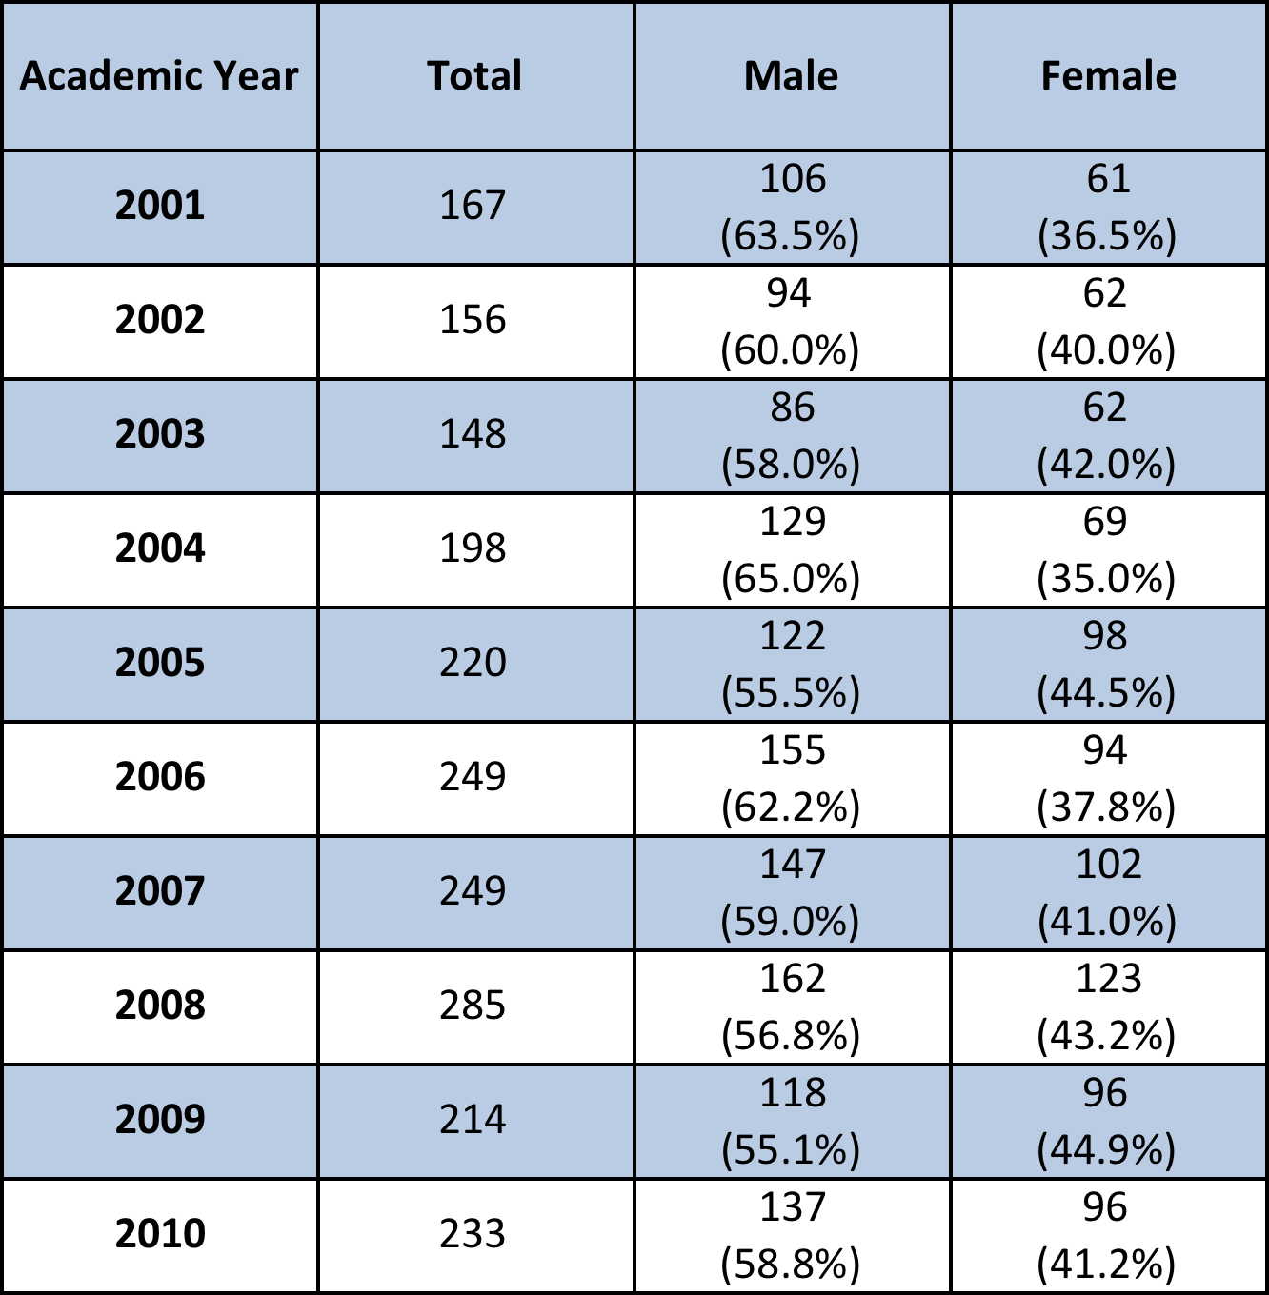
Gender Distribution of New Faculty Hires, 2001-2010

Slide 29
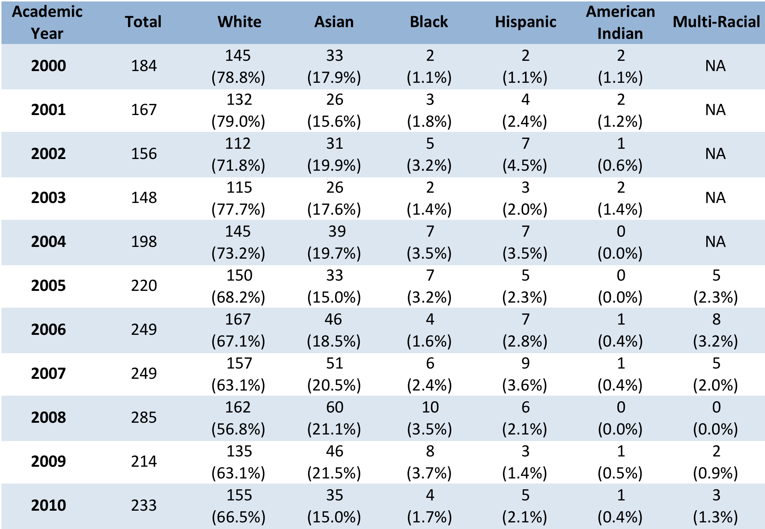
Ethnic Distribution of New Faculty Hires, 2000-2010
Notes:
For the ethnic distribution of new faculty hires, the remaining percentage since 2005 is of those who did not report an ethnic/racial identity.

Slide 30
Change in Total Tenure/Tenure-Track Faculty, 1997 and 2011

