Slide 1
Faculty Information System
New Faculty Orientation
2022

Slide 2
Welcome
FIS is a dynamic and robust system that can be used to capture the unique scholarly activities and needs of faculty members across varying disciplines. Faculty members are required to manage their own profile.
**Additional resources can be found on the Provost Website at https://vpaa.unt.edu/faculty-information-system-0**
Notes:
The purpose of this training material is to provide the UNT community with a foundational basis for managing their Faculty Information System (FIS) profile. Faculty are strongly recommended to attend an FIS training session in order to gain a more in depth and operational understanding of the UNT FIS.
Use of IE (Internet Explorer) browser is NOT recommended
For MAC users, we have found that FireFox is the browser that works best.
For Window users, please use Chrome.

Slide 3
Notes:
FIS Public Website – https://facultyinfo.unt.edu
FIS Data Entry – https://my.untsystem.edu
Workflow – https://my.untsystem.edu

Slide 4
Public Facing Site
The FIS Public Facing Site can be accessed at Facultyinfo.unt.edu
Notes:
On this site you can enter your own name, or the name of the faculty member you wish to search.
This site is READ ONLY and NO changes can be made.
This site displays your name, contact information, photo (optional), CV, education, scheduled teaching, and previously scheduled teaching. Any changes or additions made within the FIS may take up to 24 hours to appear on the Public Facing Site. Currently, we are researching how to add the feature of searching research interests.

Slide 5
Notes:
Users will need to enter their EUID (abc0123) and password to login to their my.untsystem.edu page.
Once the user has logged in they should see the Employee Resources tile, Click that tile, then look for the Digital Measures tile which contains the FIS hyperlink.

Slide 6
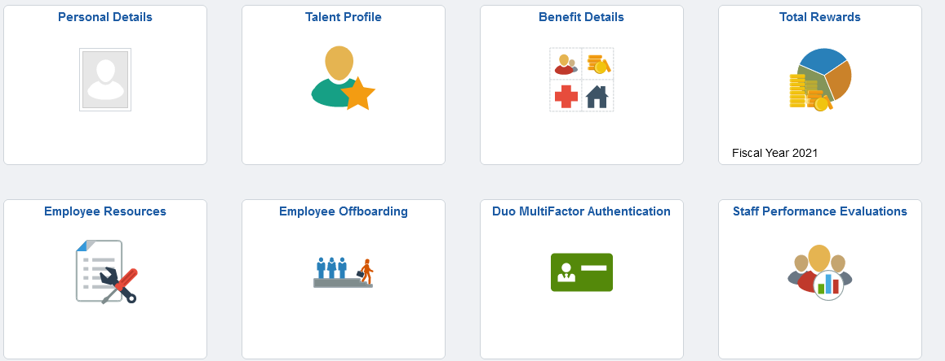
Notes:
If the FIS page does not open, please manage your pop-up blocker
If additional assistance is needed, select the FIS Administrator hyperlink to send an email to the FIS team:
We are the place to go when you need to know.

Slide 7
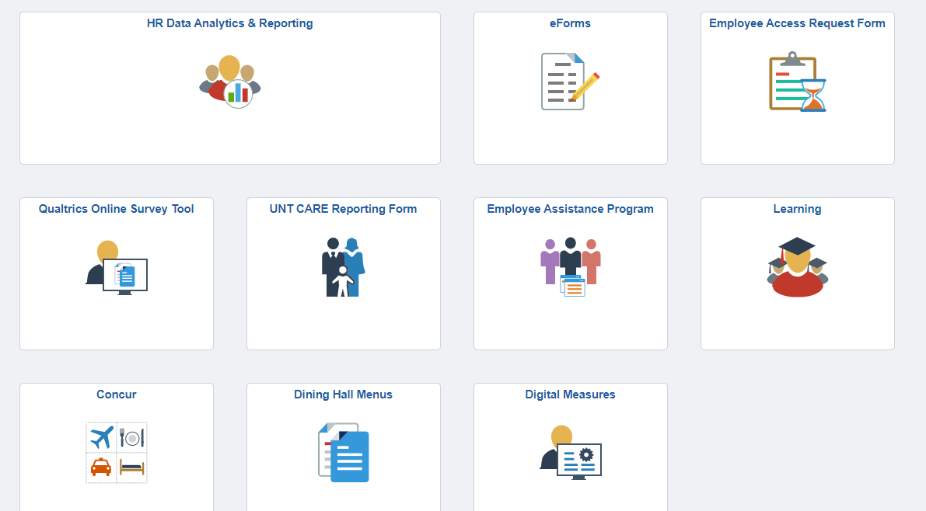

Slide 8
Notes:
On the top tool bar, you will see Activities, CV Imports, Reports, Workflow.
When you click on Activities, you will see Headings of General Information, Teaching, Scholarship, Service and Personnel.
CV Imports is a new feature, you still have to add information, but it appears to be easier when add publications.
Another feature is Pasteboard.
The PasteBoard is on the top right of the screen. It is especially important to use the PasteBoard option if you are copying and pasting from any source outside of FIS (Word, PDF, etc.).

Slide 9
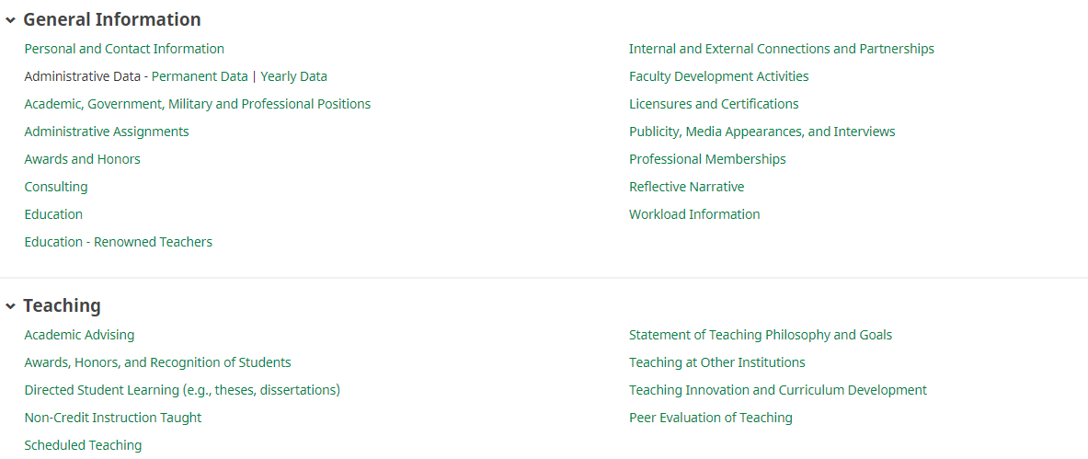
Navigating FIS
Notes:
Once users have successfully logged in to the FIS they should see the home screen which includes the following sections:
General Information
Teaching
Scholarship/Research/Creative Activities
Service
Personnel Actions
The easiest way to become familiar with the FIS and to make sure that your data is correct is to visit each screen and fill out as many fields as possible.
Not all screens or fields will need to be completed.
Think about going to the VPAA website and completing all information from the VPAA 160.

Slide 10
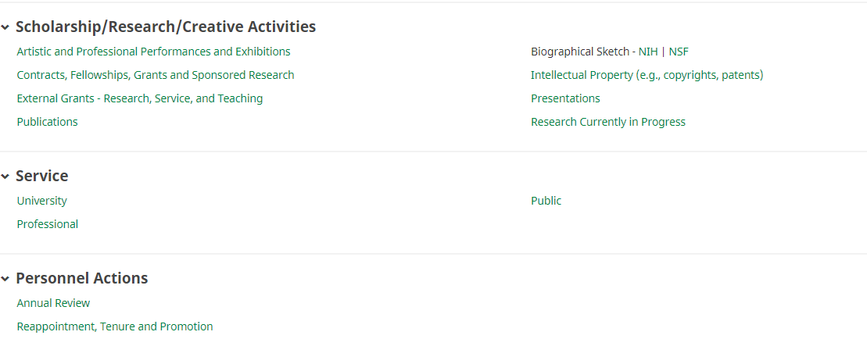
Navigating FIS

Slide 11
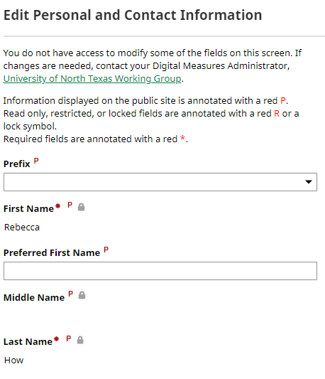
FIS Fields
Notes:
Information that will be published on the public site is annotated with a red P. There are fields that are read only, restricted, or locked. These are annotated with a red R or a lock symbol. There are some required fields and these are annotated with a red *
The fields Area of Expertise, Brief Biography and Teaching Interests is not required, but we recommend that you complete these fields as other can search the topic and connect with you and collaborate in research etc.

Slide 12
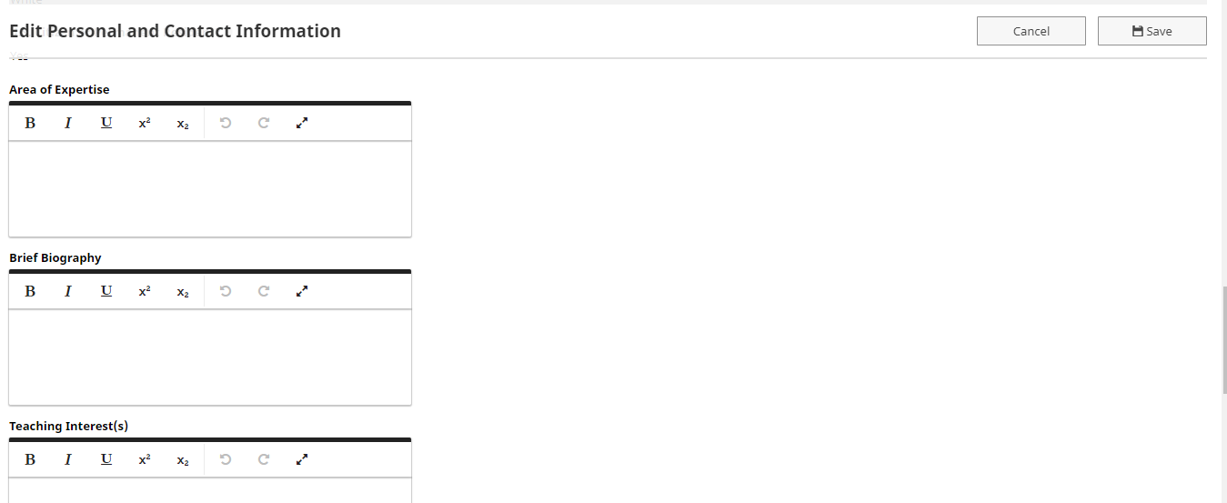
FIS Fields
Notes:
Information that will be published on the public site is annotated with a red P. There are fields that are read only, restricted, or locked. These are annotated with a red R or a lock symbol. There are some required fields and these are annotated with a red *
The fields Area of Expertise, Brief Biography and Teaching Interests is not required, but we recommend that you complete these fields as other can search the topic and connect with you and collaborate in research etc.

Slide 13
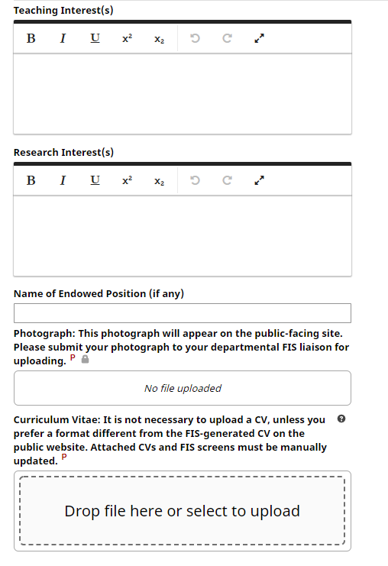
Notes:
The Public Facing site has a hyperlink that will display your CV. The CV is auto-generated based off the information that has been entered into FIS.
The option to upload a CV is also available and this will override the auto-generate function. Individuals who need a specific format for their discipline may use this option.
It is recommended that faculty use the auto-generated CV. Uploading a CV does not negate the need to enter CV information into the FIS.
If you choose to upload your CV, you will perform this function under the Personal and Contact Information screen.
The photograph field is read only.
Faculty members who wish to have their profile photograph uploaded must submit a professional photo to their department or college liaison (typically the chair’s or dean’s assistant).
The liaison will submit the photo to the FIS team for uploading.

Slide 14
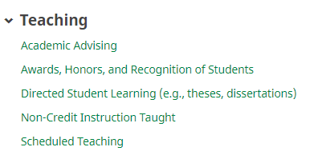
Teaching and Course Syllabi
Notes:
The FIS is integrated with People Soft and courses are automatically imported.
This is a read only screen and users cannot add additional courses.
To upload a course syllabus select the appropriate course and select Choose File next to the Syllabus for this course field. To replace course syllabus follow the same directions but the radial button will now read Replace File. Please see the screenshot on the next slide for reference.

Slide 15
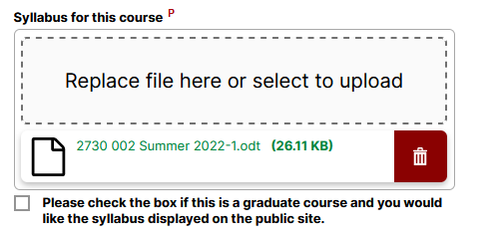
Notes:
HB 2504 does not require graduate course syllabus. UNT encourages faculty to upload graduate level course syllabi. There is a check box that you will click so the graduate course syllabus will be displayed on the public facing website.

Slide 16
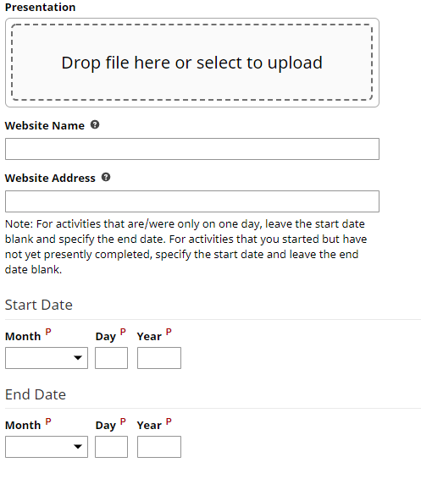
Notes:
Screens for various activities have date fields that need to be filled in.
It is important to have a start and end date for any activity that has concluded, otherwise it will default to current. This includes one-day events or awards.
It is perfectly acceptable to put the same start and end date when applicable.
If the activity has not concluded, leave the end date blank and it will default to ‘-current’ on reports, including the CV.

Slide 17
Notes:
When adding additional UNT contributors under the Scholarship/Research/Creative Activities section, the user will select additional UNT members from the drop down list.
Selecting additional UNT contributors will automatically populate the entry into those members profiles.
It is highly recommended that the primary contributor be the only individual to enter the data. If more than one user enters the data, it will lead to duplicates.
Data created by the user referencing function cannot be edited or deleted by any other users. Only the individual who entered the data can make changes. Please see the screenshot on the next slide for reference.

Slide 18
Import Function
Notes:
Users can utilize the FIS Import function to assist in managing their publications.
Data must be in a BibTex file as exported from one of the data management software or databases.
Data can also be imported from a third party using a world wide web search.
It is strongly advised to seek guidance from the FIS Team prior to using the Import function.
Other cautions when importing data:
It is possible to create duplicate records with this function.
It is possible to delete or lose all data.
Faculty members will still need to check imported records to ensure data accuracy.
Please see the screenshot on the next slide for reference.

Slide 19
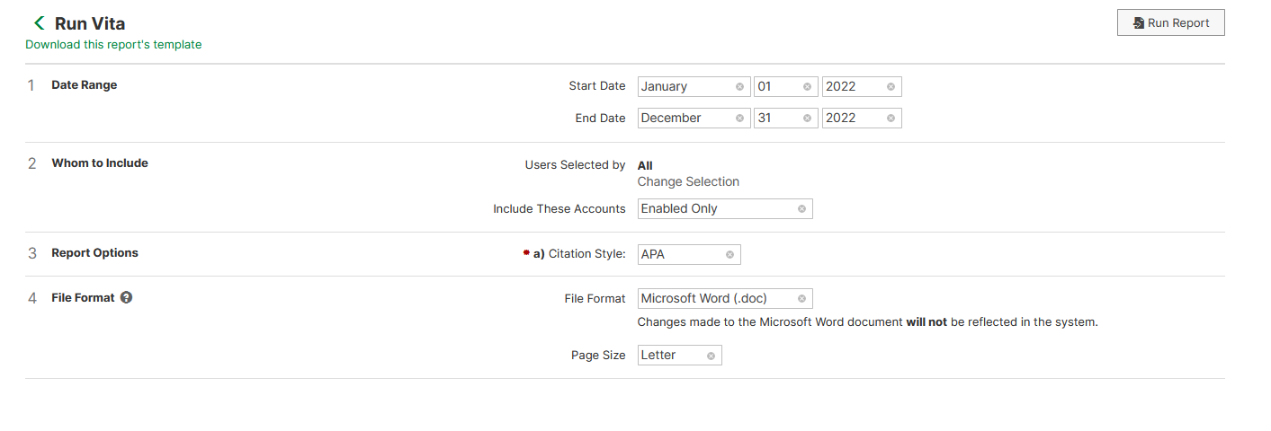
Notes:
Users are able to run the CV, VPAA-160, and ad hoc reports.
These reports can be used to identify gaps within the users data.
Department liaisons and chairs have access to these reports as well.
Users must select parameters where appropriate. This includes names, data, format, etc

Slide 20
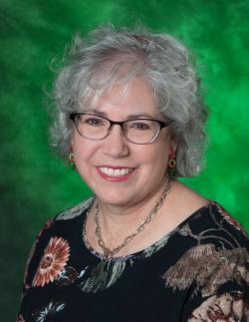
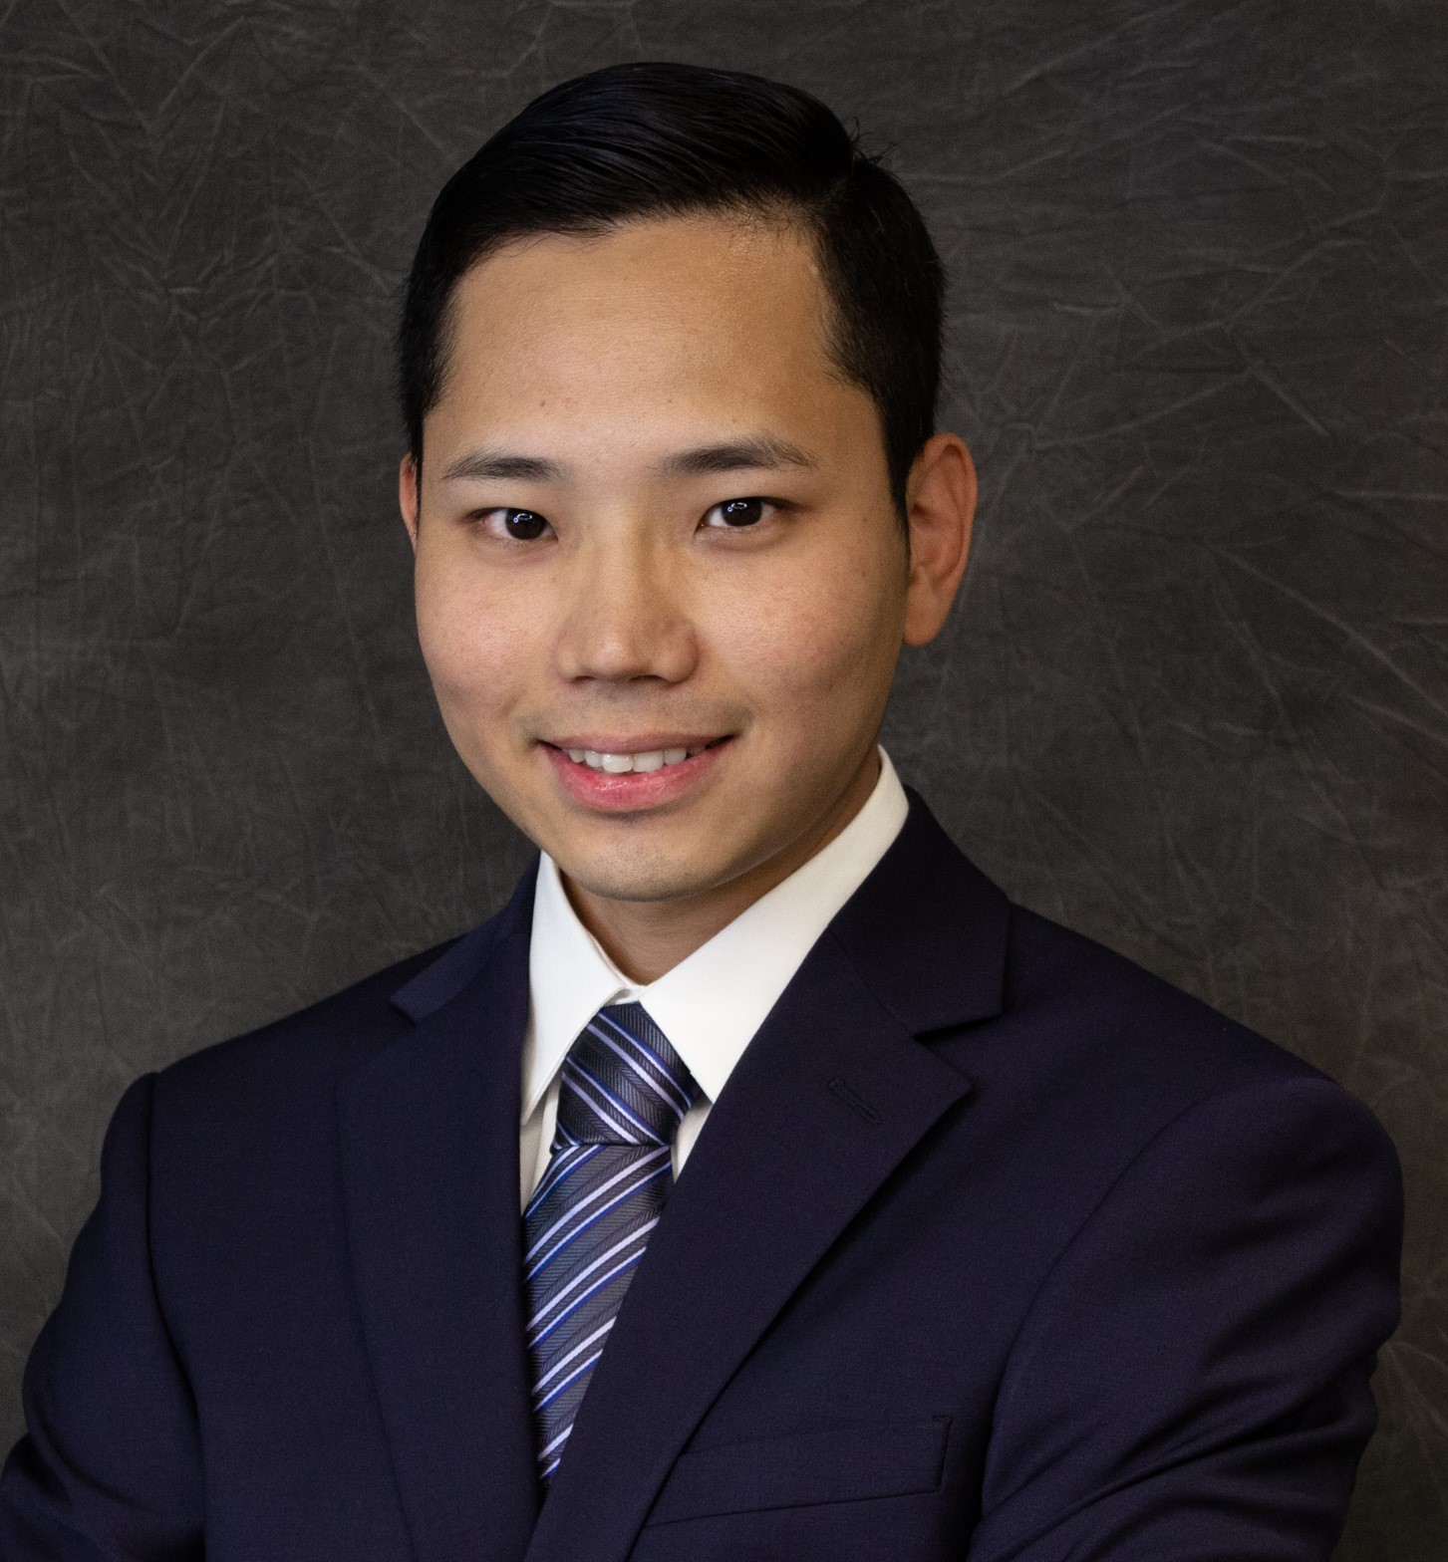
FIS Team
Rebecca How and Tsubasa Tajima
Faculty.info@unt.edu
940.360.6108

Slide 21
Thank You

