Slide 1
New Faculty Orientation will begin shortly.
Host: Terri Liles
UNT Campus Human Resources Coordinator
Questions: Please email terri.liles@untsystem.edu
We appreciate you being here, and we welcome you to New Faculty Orientation!

Slide 2
Welcome to
New Faculty Orientation

Slide 3
Agenda
11:00-11:30am
Information & Resources-
Get informed
Payroll Information
Compliance
Work/Life Balance-
Leave
Holidays
Americans with Disabilities Act (ADA)
Employee Assistance Program (EAP)
Perks-
Faculty/Staff Scholarship
Libraries
Discounts
Dining
Athletics & Fitness
Welcome to UNT!

Slide 4
Information & Resources

Slide 5
Get Informed
My UNT: https://my.untsystem.edu
A UNT portal that provides UNT community members with access to:
Employee & Manager Self Service
View Payroll information, Direct Deposit, and Benefit information and much more
Update Eagle Alert emergency contact information
E-Leave

Slide 6
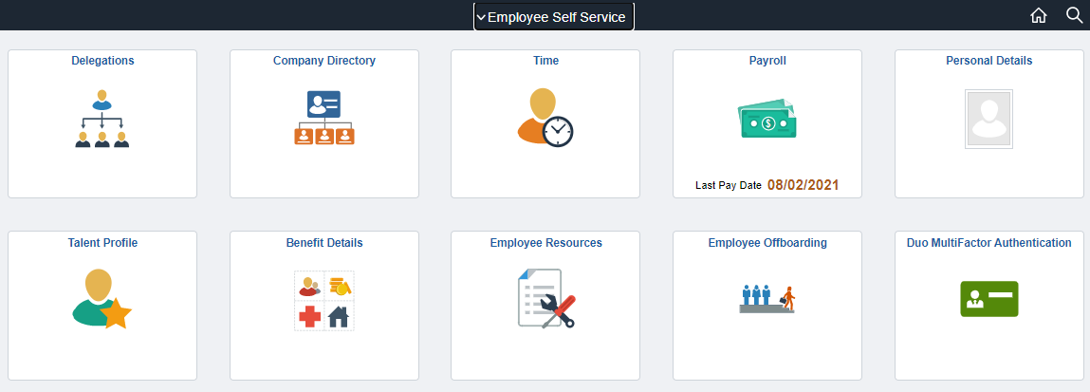
View Paychecks, Direct Deposit information, electronic W-2 & W-4
Submit & view eLeave Requests
Update Contact information
View Benefits Summary & Retirement Plan information

Slide 7
Get Informed
Human Resources
Benefits, retirement, ADA accommodations, Family Medical Leave, and hiring, performance management and employee relations for staff
Academic Resources
Faculty compensation and hiring
Salaried Graduate Student Assistant compensation and hiring
Career Center
Hourly Student Hiring and student services
Business Support Services
Payroll, Travel, Purchasing

Slide 8
Payroll Information
When Do I Receive My Paycheck?
Pay day is on the 1st of the month for employees paid monthly.
Pay day is on the 1st and 15th of each month for employees paid semi-monthly.
If a pay day falls on a weekend or holiday, the next business day is designated as pay day.
Each department on campus has a representative (Timekeeper) responsible for submitting time to the Payroll Department.
Direct Deposit
Direct deposit can be completed/updated at https://my.untsystem.edu and should be done before the payroll is completed for the month.
Payroll runs around the 15th of the month to be paid the first working day of the following month.
If it is submitted after payroll runs then the first check will possibly be a paper check that will be mailed to the Home Address the employee has on file. Addresses can be verified/updated on https://my.untsystem.edu.
Paystubs are available on https://my.untsystem.edu.

Slide 12
Compliance
The Office of Compliance and Ethics mission: Establishing a Compliance and Ethics program that clearly demonstrates the university's commitment to the highest standards of ethics and in compliance with all applicable regulatory requirements by its faculty, staff, and students.
What can you do?
Put forth best effort in serving the citizens of Texas and students from around the world
Model ethical conduct
Ensure compliance training is completed
Report suspected wrongdoing
Read the UNT Standards of Conduct
Report information anonymously to: https://secure.ethicspoint.com/domain/media/en/gui/56566/index.html

Slide 13
Work/Life Balance

Slide 14
Leave
Sick Leave
Full-time employees earn 8 hours of sick leave per month. Part-time faculty & staff (working 20 hours or more) generally earn 4 hours of sick leave per month.
Family Medical Leave
Entitles eligible employees to take up to 12 weeks of unpaid, job-protected leave for specified family and medical reasons. The eligibility requirement specifies that the employee must have at least 12 months of state service and have worked at least 1,250 hours in the twelve months preceding the leave (more information).
Sick Leave Pool
Awarded to qualified employees who suffer or have immediate family members who suffer a catastrophic injury or illness that causes the employee to exhaust all of his/her accrued leave (more information).
Sick Leave Donation
Sick leave donation is a program that allows all eligible employees to transfer sick leave hours voluntarily to another eligible employee within the same agency (more information).

Slide 15
Holidays
Fiscal Year 2022
(September 1, 2021 – August 31, 2022)
Labor Day
first Monday in September (September 6, 2021)
Fall/Holiday Break
fourth Thursday and Friday in November (November 25 - 26, 2021)
Winter/Holiday Break
(December 24; December 27- 31, 2021)
Martin Luther King Jr. Day
third Monday in January (January 17, 2022)
Memorial Day
fourth Monday in May (May 30, 2022)
Independence Day
Monday, July 4, 2022
https://www.untsystem.edu/hr-it-business-services/payroll/holidays-all-locations

Slide 16
Americans with Disabilities Act (ADA)
The University of North Texas can provide reasonable accommodations for qualified individuals with disabilities in all terms and conditions of employment and application.
If an employee is having trouble performing their job or aspects of their job due to a disability (temporary or permanent), please contact Human Resources or visit the Human Resources website for more information.
There are two forms to be completed in order to complete the interactive process for accommodations:
Request for Disability Accommodation in Employment
Medical Practitioner Certification

Slide 17
Employee Assistance Program (EAP)
Alliance Work Partners can assist you with these challenges and more:
Employees may self-refer to EAP or managers may refer an employee. EAP consultations (up to four per year, per situation) are free and confidential.
For information: https://hr.untsystem.edu/employee-assistance-program
Job Performance | Personal Concerns | Marital difficulties
Child & Elder care resources | Parenting support | Time management
Family issues | Anger management | Stress management
Communication skills & anxiety | Weight loss | Managing depression
Legal & financial resources | Career management | Grief & bereavement
Alcohol/substance abuse | Self-improvement plans | Smoking cessation
To speak to a counselor: 1-800-343-3822,
any time 24 hours a day, 365 days a year
Or access benefits online at https://www.awpnow.com
Servicios en español disponibles

Slide 18
UNT Perks

Slide 19
Perks
Faculty/Staff Scholarship
Full-time employees, part-time employees with 5 years of service, retirees, and dependents are all eligible. Must re-apply each semester.
For more information, see the policy at https://policy.unt.edu/policy/10-025
https://sfs.unt.edu/sites/default/files/Faculty%20Staff%20Scholarship%20Informational%20Form%2012172019_0.pdf
Libraries
Access to all UNT, UNT-HSC and UNT Dallas libraries’ resources with UNT or System ID.
Visit University Libraries page for more information about resources and services: https://library.unt.edu/

Slide 20
Perks
Libraries
Document Delivery and Interlibrary Loan
Course Reserve
ID Grant and Funding Opportunities
Scholarly Communication
Subject Librarians
Library faculty specializing in specific subject areas
Library instruction and research support for you and your classes, including individual appointments
Partner to create help guides for your students tailored to your course or assignment
Request collections materials

Slide 21
Perks
Libraries
Resources Beyond Books –
Media Library: films, documentaries, games
The Nest, the e-sports gaming space (Chilton Hall & Discovery Park)
UNT Digital Library: The Portal to Texas History, UNT Scholarly Works institutional repository, web archives, Congressional Research Service (CRS) reports
Music Library: Scores, monographs, sound recordings, CDs
Eagle Commons Library: Government Documents, Law, Political Science, Geography and Business collections
Special Collections: Maps, archival collections, photos, art and artifacts, rare books, and miniature book collection
The Spark Makerspace (Willis Library): Audio/visual equipment, electronics, programming, prototyping, 3D Printing, die & laser cutting, sewing machines, weaving looms, hand/electric tools, and reference materials
Diversity & Inclusion Resources
Neurodiversity Resources for UNT Faculty & Staff

Slide 22
Discounts
Cellular Phone Service Discounts
AT&T, Sprint, Verizon and T-Mobile offer discounts to UNT Staff and Faculty for their monthly personal cell phone service costs.
Go here for more details.
Software and Bookstore Discounts
Employees have access to free and discounted software:
MS Office 365 is available free to faculty and staff for home use.
Adobe Creative Cloud is also available to faculty and staff for home use in accordance with the system's Enterprise Term License Agreement for Education.
Click here or on the word Software (above) to download your copy of MS Office and/or Adobe CC now. Registration is required.
Other academic-priced software for many platforms is available to faculty and staff from campus bookstores: Faculty/staff Id is required to receive the discount. Faculty and staff also receive discounts on merchandise during special appreciation events and sales:
UNT Bookstore
PerkSpot / PerksConnect
Offer discounts on apparel, auto, movie tickets, travel, computers, electronics and much more!
For more information on all available perks and discounts, visit the UNT System Perks page.

Slide 23
On-Site Services
Optometrist
College Optical Express (COE) is a full service optical office located on campus. COE accepts UNT vision coverage and grants a substantial discount for all UNT-affiliated patients with proper identification. This includes current students, faculty, staff, and alumni, as well as UNT-affiliated family members. Contact the COE at 940-369-7441 or www.coeunt.com.
Pharmacy
As a state-owned, fully-licensed pharmacy, the Student Health & Wellness Center Pharmacy is open to all eligible students, faculty and staff, with a UNT ID card. Contact the pharmacy at 940-565-2790 or http://studentaffairs.unt.edu/pharmacy.

Slide 24
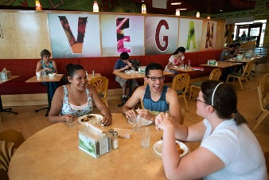
On-Site Campus Dining Options
Dining Halls:
Bruce Dining Hall
Champs Cafeteria at Victory Hall
Eagle Landing
Kitchen West at West Hall
Mean Greens Café at Maple Hall
The Union:
Avesta Restaurant
Burger King
Campus Chat Food Court
Chick-fil-a
The Corner Store
Fuzzy’s Taco Shop
Jamba
Krispy Krunchy Chicken
Starbucks
Taco Bueno
Which Wich
Where to eat?
Discovery Park:
Discovery Perks Market
Discovery Perks Grill
Grab-and-Go:
Biz Café (Business Leadership Building)
Café GAB (General Academic Building)
Khush Roti (between Sycamore & GAB)
Starbucks Stand (between Hurley & the Music building)
Faculty/Staff Meal Plans:
Meals range from $5.00 - $6.25 each
Meal plans are loaded onto UNT ID card
Meal plans can be purchased online at: https://dining.unt.edu/fs
For up-to-date locations and hours: https://dining.unt.edu/hours

Slide 25
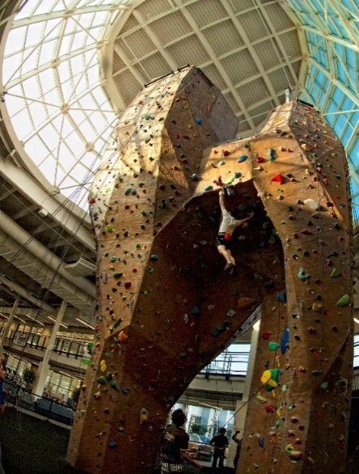
Athletics & Rec Center
Mean Green Athletics
Pohl Recreation Center
The Rec Center is a 138,000 square foot facility that features an indoor climbing wall, lap pool, 1/8 mile walking/jogging track, multi-purpose courts for basketball, volleyball, badminton and much more!
Football
Basketball
Volleyball
Swimming & Diving
Softball
Golf
Soccer
Cross Country
Track & Field
Tennis
For tickets, call 940-565-2527 or go to
http://www.meangreensports.com/tickets/ and ask about Faculty/Staff season and single game ticket discounts.
Faculty/Staff Fitness Program
UNT faculty & staff are eligible to purchase a membership to the Rec Center at a discounted rate.
Employees may request fitness leave up to 30 minutes 3 times a week with supervisor approval.
This must be tied to the beginning or end of the work day or lunch period.

Slide 26
Questions?

