Slide 1
Faculty Development Leave Workshop
April 6, 2023

Slide 2
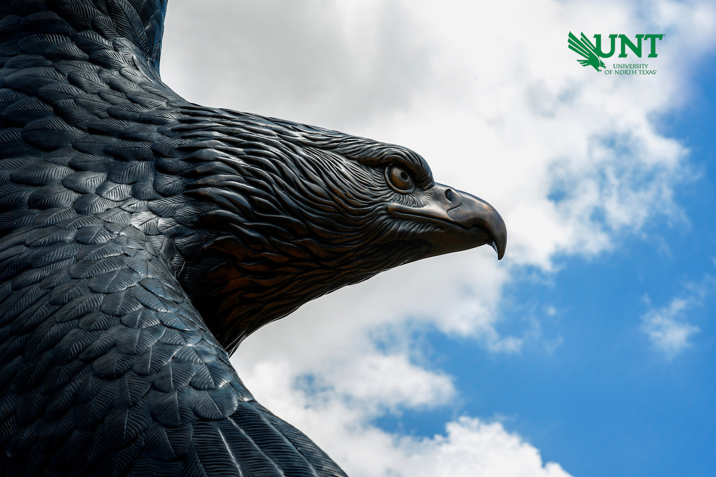
Agenda
Welcome and Introductions – Vice Provost Hutchins
FDL Overview
William Cherry, FDL Committee, Faculty Senate
FDL Panelist
Ananth Seetharaman
Amanda Bennett, Director of Global Partnerships and Engagement
Academic Resources

Slide 3
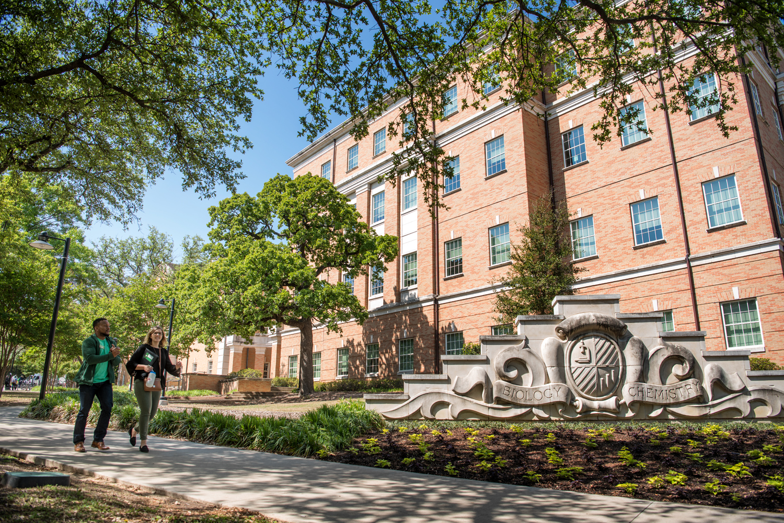
Faculty Development Leave (FDL, 06.010)
Development leaves are authorized for the primary purpose of increasing the value of the recipient’s contribution to the University by providing an opportunity for professional growth.
May be granted for study, research, writing, field observations or other suitable purposes
Due in late September (9/25/23)

Slide 4
FDL Eligibility
Must be a full-time member of faculty or staff
At UNT for at least six consecutive academic years following initial employment or return from prior FDL
Individual may not be in the terminal year of employment at UNT

Slide 5
FDL Duration & Comp/Benefits
Faculty on 9-month appointments may be granted leave for either one long semester or two consecutive long semesters
1 long semester: full salary and benefits
2 Long semesters:
May be separated by summer terms
Would receive 50% of salary, 50% health insurance and life coverage (25% dependent insurance)
Sick leave accruals would be decreased to 4 hours (50%) per month

Slide 6
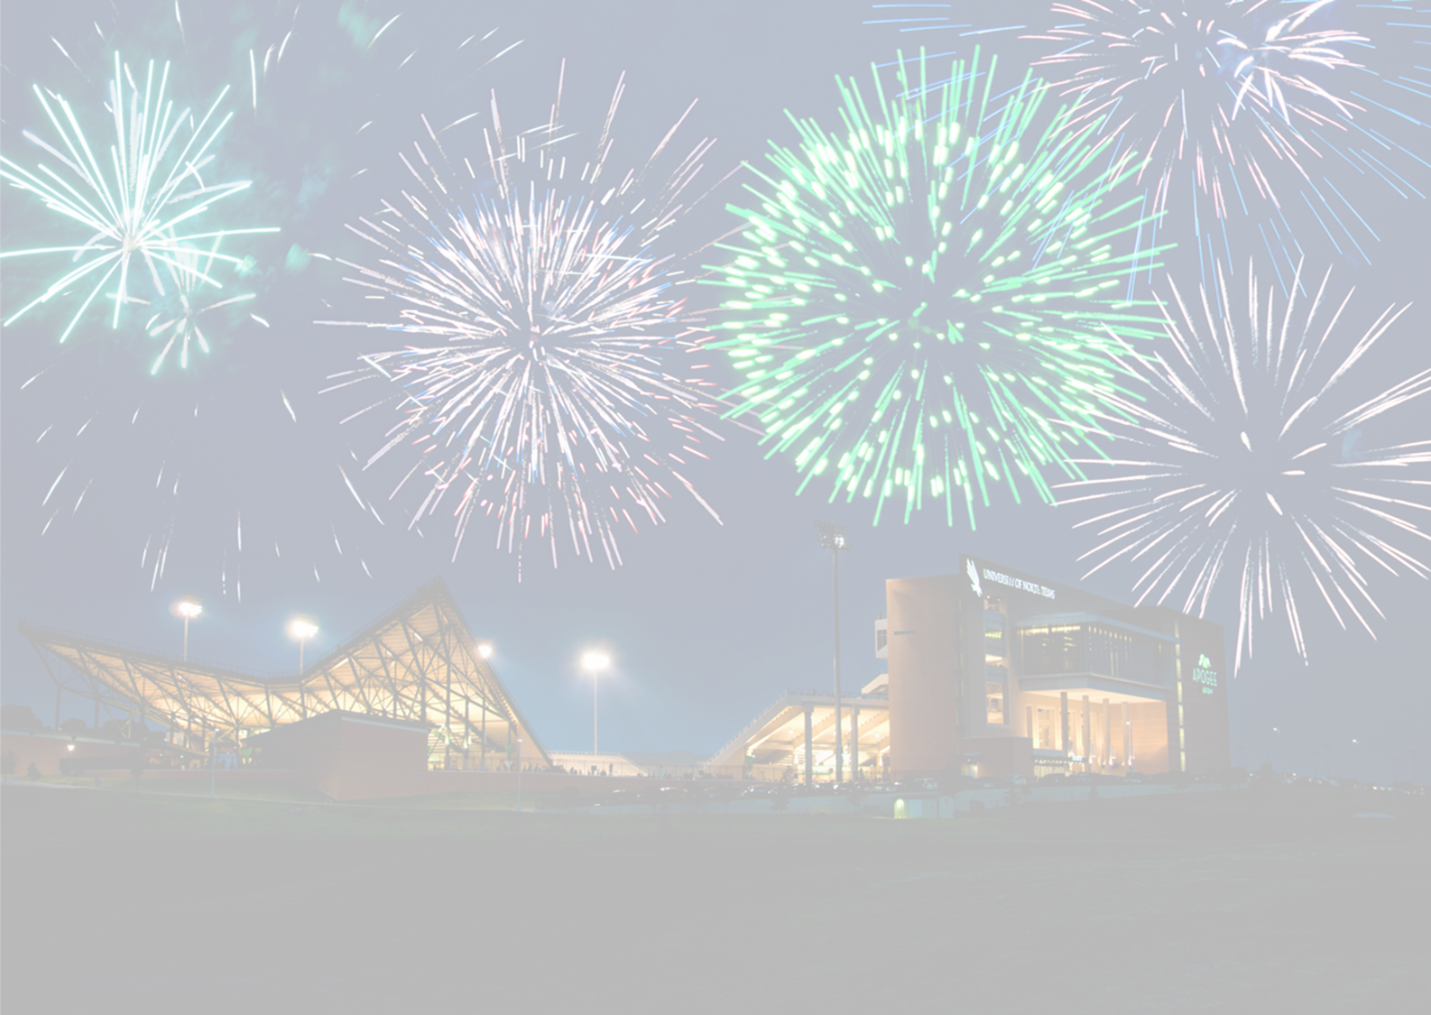
Successful FDL Applications – from FDL Committee
High impact and beneficial to professional growth and departmental goals
Collaboration with other faculty from peer institutions with national/international scope – consider a Fulbright*
Increase of UNT’s national and international visibility
Clearly outlined research agenda*
Feasibility of project realistic to completion in a timely manner

Slide 7
Fulbright Scholar Program/Workshops and Resources
Fulbright Scholar Program
Overview: Provides research, teaching, or research and teaching opportunities abroad
Eligibility: Must hold U.S. citizenship at the time of application and demonstrate requisite degree and experience
Duration: varies by award; 2-12 months
Location: Provides awards to about 135 countries
Application Deadline: Annual Submission Deadline in Mid-September
2024-25 Awards:
Applications Now Open!
Application Deadline: September 15, 2023
Additional Information:
https://cies.org/us-scholar-awards#overview
Workshops and Resources
UNT Workshops Spring 2023 May 5 | 12-1 p.m. via Zoom
Register for a session
Institute of International Education (IIE) Webinars
Multiple Sessions
Register for a session
Note: IIE posts recordings at Webinar Archive
UNT Application Guidance
Schedule a meeting with UNT’s Fulbright Scholar Liaison and/or UNT’s Faculty Associate for Fulbright Programs at Fulbright@unt.edu

Slide 8
Benefits of Aligning Fulbright Scholar Program with
Faculty Development Leave
Application Symmetries
Similar application deadlines: Fulbright U.S. Scholar Program (September 15, 2023) and FDL (September 2023)
Allows you to demonstrate in your Fulbright application how your proposed project aligns with your professional goals and career trajectory at UNT
Allows you to demonstrate in your FDL request how Fulbright contributes to your professional growth
Leave and Compensation
Align Fulbright award (stipend) with a UNT leave period and compensation per UNT’s policy on FDL
Maximizes opportunities for professional development during your FDL
Enriches your FDL experience (study, research, writing, field observations, etc.)
Enables you to establish a professional network with international collaborators and develop international collaborations
Enhances your knowledge and intercultural competencies
Advances your international teaching/research
Empowers you to contribute to campus internationalization at UNT

Slide 9
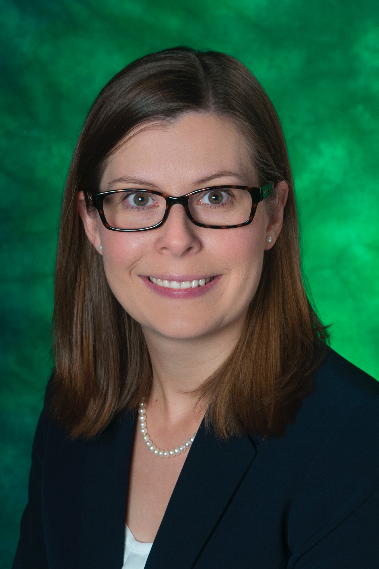
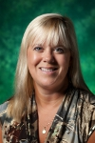
Questions
Fulbright Program Advisor and Scholar Liaison Amanda White Bennett, Ph.D. Director of Global Partnerships and Engagement UNT International Affairs Fulbright Scholar to Japan, 2014
Faculty Associate for Fulbright Programs Carol Anne Costabile-Heming, Ph.D. Professor of German UNT World Languages, Literatures and Cultures Fulbright Scholar to Germany, 2002

Slide 10
Successful FDL Applications – from FDL Committee cont’d.
Reviewer-friendly language for committee members outside the area of the applicant’s expertise
Adequate justification for selection of leave category (i.e., research, creative, renewal)
Strong recommendation letter from chair/dean
Supporting materials (i.e., letters, contracts, grant approvals) attached to the application

Slide 11
FDL Submission Process
Email Academic Resources Academic.Resources@unt.edu that you would like to apply
Application Open in FIS, once completed submit for Chair Review
Chair and Dean Review Application in FIS Workflow by September 25th
University FDL Committee for recommendation to Provost
FDL approved then transmitted through the President to the BOR for approval
Faculty Informed of final decision after BOR Meeting

Slide 12
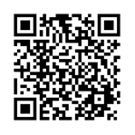
Tell us how we did!
Please provide some feedback on our workshop. We use your feedback this each term to update our workshops. Choose “Faculty Development Leave”.
https://unt.az1.qualtrics.com/jfe/form/SV_agw7GbxvUpsXHO6

Slide 13
Questions, Comments, Wonderings?

