Slide 1

UNT Lecturers and Clinical Faculty:
Path to Promotion
January 28, 2020

Slide 2

Promotion
We see this process as one of the most important steps any university can take.
Goal: we want this process to be fair and as transparent as possible.

Slide 3
Promotion and Annual Review Policies
Non-Tenure Track Faculty Reappointment and Promotion Policy (06.005) and the Annual Review Policy (06.007) can help develop a framework towards success.
Be familiar with your own departments’ and colleges’ criteria, procedures, and deadlines.

Slide 4
University Promotion Criteria and Timing: Senior Lecturers
Excellence in teaching; sustained effectiveness in service
One should have at least 3 consecutive years (6 semesters) as a lecturer before applying.
Professional experience may count.
Work with your chair to determine the opportune time for promotion.
But: college rules can differ!
From UNT Policy 06.005

Slide 5
University Promotion Criteria and Timing: Principal Lecturers
Sustained excellence in teaching and service
Before applying, one should have
  at least 5 consecutive years (10 semesters) of full-time college-level teaching.
  At least 3 years (6 semesters) at the rank of Senior Lecturer.
Professional experience may count.
Work with your chair to determine the opportune time for promotion.
But: college rules can differ!
From UNT Policy 06.005

Slide 6
University Promotion Criteria: Clinical Associate Professor
Excellence in primary domain; sustained effectiveness in the others
One should have at least 5 consecutive years (10 semesters) at the rank of Clinical Assistant Professor before applying.
Professional experience may count.
Work with your chair to determine the opportune time for promotion.
But: college rules can differ!
From UNT Policy 06.005

Slide 7
University Promotion Criteria: Clinical Professor
Excellence in primary domain and all other workload assignments
One should have at least 5 consecutive years (10 semesters) in college-level clinical, professional, or practicum assignments, including at least 3 years (6 semesters) at the rank of Clinical Associate Professor before applying.
Professional experience may count.
Work with your chair to determine the opportune time for promotion.
But: college rules can differ!
From UNT Policy 06.005

Slide 8
Teaching
Examples of excellence in teaching valued by the University include but are not limited to evidence that the faculty member:
Engages students with knowledge
Develops learning goals and assesses outcomes
Applies effective pedagogical practices
Develops/applies technological innovations
Exposes students to service learning experiences
Mentors/supervises students
From UNT Policy 06.007

Slide 9
Teaching (cont’d)
Examples of excellence in teaching valued by the University . . . .
Expands students’ abilities and workforce readiness skills.
Leads study abroad experiences.
Creates quality collections of library, media, internet resources that support curricula areas.
Helps students advance their professional careers.
…and others
From UNT Policy 06.007

Slide 10
Service and Engagement
Evidence to assess the quality of service and engagement may include:
Demonstrated leadership and engagement in professional organizations, community-based initiatives, and University enterprises.
Support and mentoring of colleagues, including promoting the internal and external recognition of professional colleagues in support of institutional and disciplinary recognition, growth, and advancement.
Engagement in student recruitment, retention, and success.
From UNT Policy 06.007

Slide 11
Service and Engagement (cont’d)
Initiation and promotion of projects that advance the department, college, and/or University and improve their internal and external reputations.
Other evidence as defined by the unit (e.g., department or college).
From UNT Policy 06.007

Slide 12
To Do’s
Identify an achievable set of personal and professional goals and develop a realistic plan to meet them.
Align your time with your department’s and UNT’s priorities. What can you contribute?
Time management: ensure that your goals are realistic and doable.
Meet often with your chair and members of your unit review committee.
Identify mentors for long-term success.
Develop a network of accountability and support.

Slide 13
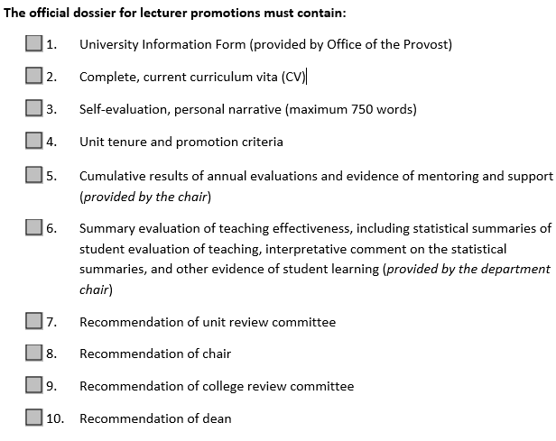
Dossier (VPAA-170a)

Slide 14
Approximate Timeline*
Early May: Departments notify deans of possible promotion candidates
May-August: Candidate prepares dossier
Late August: Candidate submits dossier to chair
Mid-October: Departmental recommendations go to dean
January: Dean’s recommendation goes to Provost
Mid-Spring: Provost’s decision
* Departmental and College deadlines can vary: be sure to check yours!

Slide 15
* Departmental and College deadlines can vary: be sure to check yours!

