Slide 1

Faculty Resources
Office for Faculty Success
Hurley Administration, Suite 135
Dr. Linda Holloway
Interim Associate Vice Provost for Faculty

Slide 2
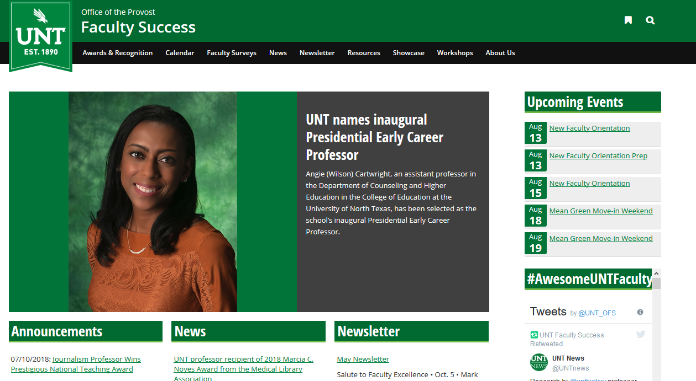
https://facultysuccess.unt.edu

Slide 3
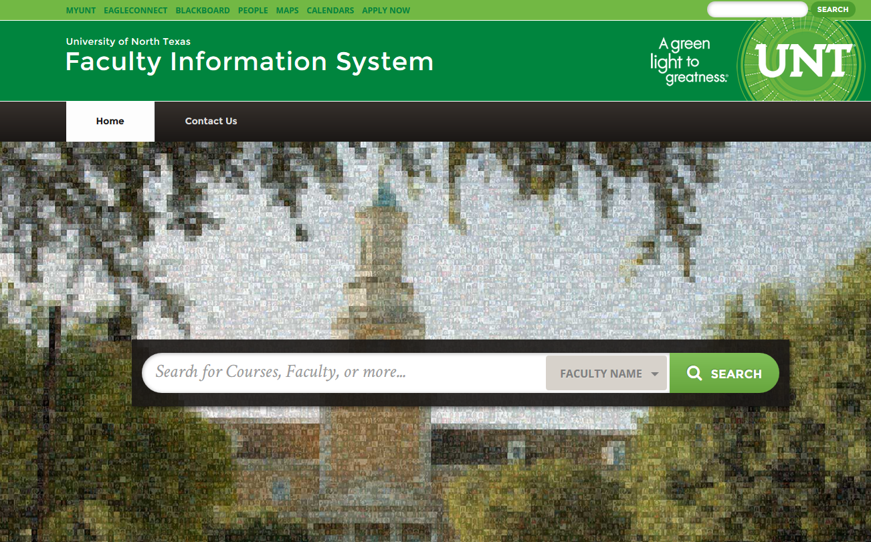
Faculty Information System (FIS)
Faculty must upload syllabi to FIS each semester and keep profiles current
Access via my.unt.edu

Slide 4


Slide 5
Faculty-Led Affinity and Research Groups
Affinity Groups:
  Black Faculty Network
  International Faculty Network
  La Colectiva: Faculty Women of Color LGBT Faculty Network
  Women’s Faculty Network
  Autism Support and Advocacy Group
Research:
  Faculty Writing Group

Slide 6


Slide 7
English Proficiency Form
All instructional personnel must complete and return this form by September 13.
If English is not your native language but your academic training was in English, please list English and your native language in the primary language blank.
A form is in your packet; we’ll also email it to you.

Slide 8

PHOTOS
Faculty
University Relations, Communication, and Marketing
To make an appointment, you may contact Gary Payne via email at Gary.Payne@unt.edu or Sarah Stevens at Sarah.Stevens@unt.edu at (940) 565-2475.

Slide 9





UNT College of Music presents:
Fall 2019 Concerts
at the
Murchison Performing Arts Center
2 FREE tickets for New Faculty Members
Contact Jordan.Batson@unt.edu or performance times and tickets 48 hours prior to event.

Slide 10

UNT Department of Dance and Theatre Presents:
2019-2020 Season Shows at the University Theatre
Contact Dance & Theatre Box Office 2 complimentary tickets. 565.2428
(Code Word: New Faculty)

Slide 11
DATES TO REMEMBER!

Slide 12

Thursday, Sept. 12, 2019
Doors open at 2:15 p.m.
Presentation begins at 3 p.m.
Reception to follow
Murchison Performing Arts Center

Slide 13
Promotion and Tenure Workshops
Fall 2019 Semester
For Tenure System Faculty:
September 23
11:00 – 12:00 p.m.
Union 385
October 22
3:00 – 4:00 p.m.
Union 385
For Non-tenure Track Faculty:
September 26
3:00 – 4:00
Venue TBD
October 9
11:00 – 12:00
Venue TBD
∼ ∼ ∼ ∼ ∼
Spring 2019 Semester
For Tenure System Faculty:
January 23
2:00 – 3:00 p.m.
Discovery Park
January 24
2:00 – 3:00
Union 385
For Non-tenure Track Faculty
January 28
1:00 – 2:00
Venue TBD
∼ ∼ ∼ ∼ ∼

Slide 14







Slide 15

Mentoring Luncheon
October 3, 2019
11:30 – 1:30 PM
Union, Room 333

Slide 16

Faculty who complete the program receive a $1000 stipend for professional development
Check your email for the invitation

Slide 17

For Assistant Professors, Lecturers, Assistant Librarians, and Clinical Assistant Professors

Slide 18

Mentoring Programs at UNT
Who’s Involved?
  New assistant professors, clinical assistant professors, librarians, and lecturers
Why?
  We think mentoring is a critical part of our newest colleagues’ success
  (and it’s required)

Slide 19
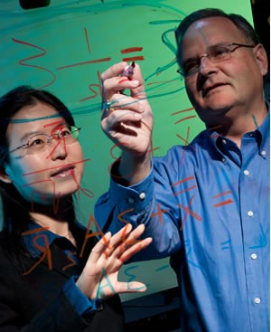
Mentoring Programs at UNT
Traditional Mentoring:
  Your mentor will help you understand departmental culture and expectations, as well as standards of your discipline
  Work with your chair to identify a mentor (usually) from within your unit

Slide 20
For Tenure-Track Faculty

Slide 21
Junior Faculty Summer Research Grant Election
Who’s eligible: Indicated in your offer letter, generally Assistant and Associate Professors hired without tenure
One time support of $5,000 for summer salary or operating funds (can be deferred for one year if requested)
Written election of how you would like to receive these funds (salary or operating funds) is required
  Forms will be emailed to those who received this grant in their offer
  Please consult with your department chair on best way to utilize funds
  Form must be submitted to Academic Resources before 9-1

Slide 22
For Assistant Professors

Slide 23

Conference Support
$1,000 provided to support conference travel
Eligibility:
  Assistant Professors in their second or third years
  Must participate fully in Office for Faculty Success mentoring programs
Application and report forms can be found on the OFS webpage.

Slide 24
Creative and Research Enhancement Activity Time for Engagement Program
(CREATE)
$4,000 provided to support a 4-week stay at another institution outside DFW
  $1,000 supplement possible
Eligibility
  Assistant Professors in their fourth or fifth years
  Must participate fully in OFS mentoring programs
Application and report forms can be found on the OFS webpage.

Slide 25

Your Orientation and Onboarding Experience
NFO Survey: please complete! Join us on social media to access the survey and share your experience with #2019UNTNFO
  Twitter: @UNT_OFS
  Facebook: Faculty Success at UNT
Onboarding Survey: coming to you in September

Slide 26
Thank You!
For more information please contact:
Dr. Linda Holloway
Associate Vice Provost for Faculty
(940) 565-3987

