Slide 1
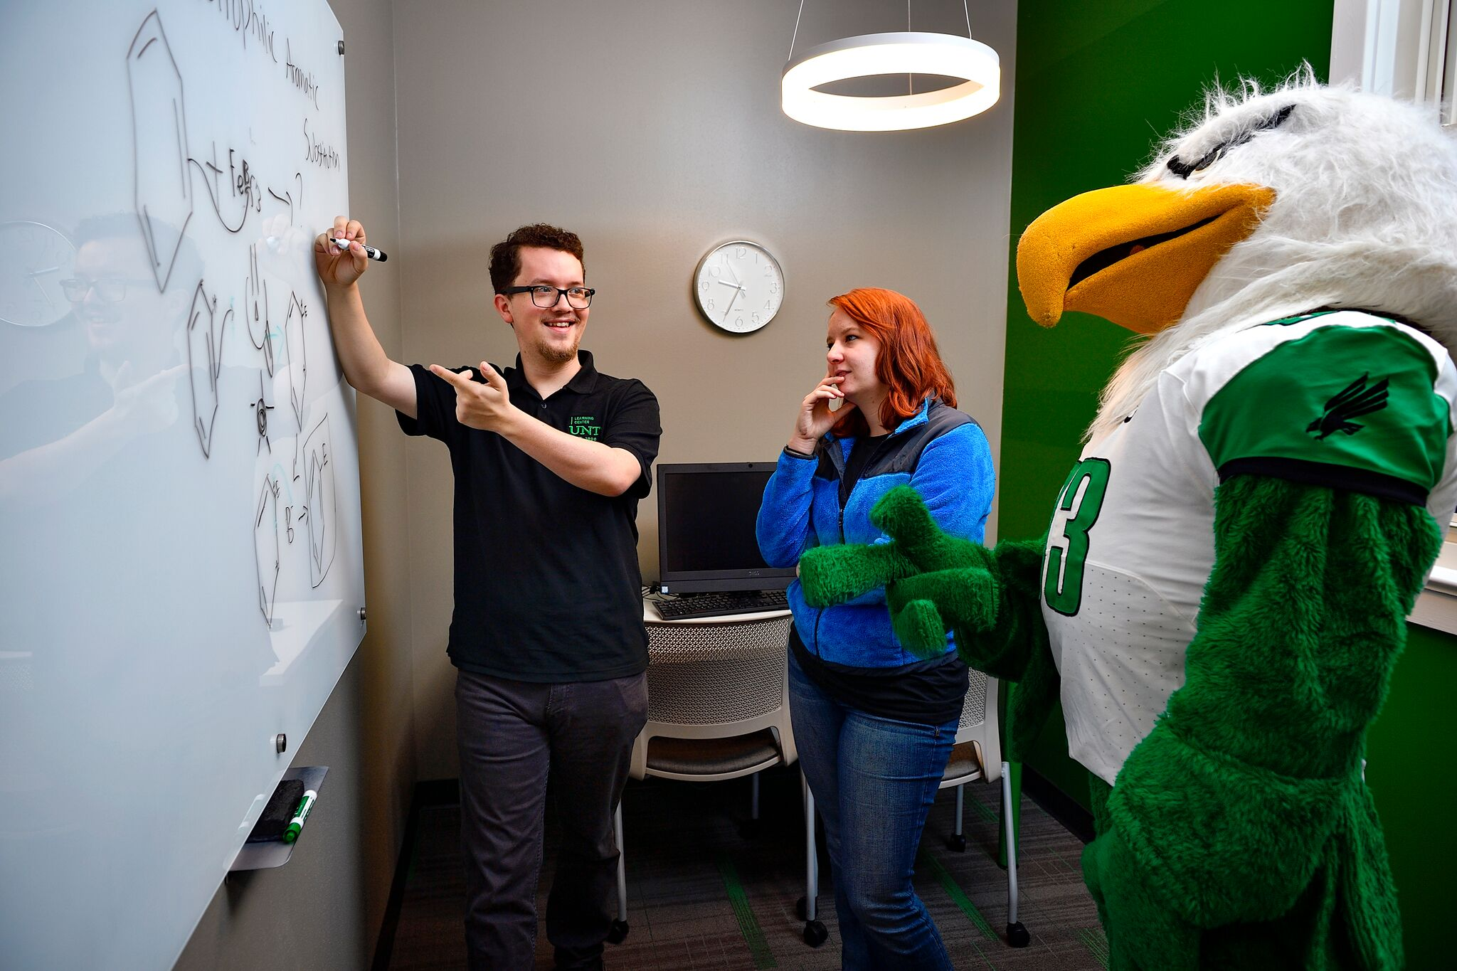
Supporting Student Success

Slide 2
Supporting Student Success
Christy Crutsinger, Vice Provost for Academic Affairs
Roxanne Davenport, Director, Learning Center
Tamara Knapp-Grosz, Director, Counseling and Testing Services
Maureen McGuinness, Dean of Students/ AVP Student Affairs
Karen Weiller, Academic Integrity Officer and Academic Affairs Fellow
Lisa Maxwell, Director, Academic Advising
Katy Washington, Director, Office of Disability Access

Slide 3
Outlining Expectations
Take home quizzes are the norm for the Advanced Calculus course that you teach. You notice that four students who often sit together in class and appear to be friends are receiving the same grades on their quizzes. Upon closer review, you notice that not only are the answers the same but the solutions as well. It is obvious that they have worked together.

Slide 4
UNT Resources
UNT Policy, 06.049 Course Syllabi Requirements
UNT Policy 06.003, Student Academic Integrity
Teaching Excellence Handbook
http://policy.unt.edu
http://teachingcommons.unt.edu/teaching-handbook

Slide 5
Observing Religious Holidays
The first day of class you review your syllabus for the upcoming semester. You highlight exam dates, assignments, and attendance requirements for the course. After class James approaches you and tells you that he can’t take a test on the planned date because he will be observing Yom Kippur. The only university holidays that you are aware of are Labor Day and Thanksgiving.

Slide 6
UNT Resources
UNT Policy, 06.039 Student Attendance and Authorized Absences

Slide 7
Giving Early Feedback
You teach an upper division course and have one major assignment (50%) and one final exam (50%). After you return the assignment on November 7, you are approached by several students who received failing grades. The students are upset because the last day to drop the course was November 5.

Slide 8
UNT Resources
UNT Registrar
Faculty First Flight Program
Center for Learning Enhancement, Assessment and Resign
Learning Center

Slide 9
Considering Classroom Alternatives
As you are preparing your syllabus, you realize that a conference will take you way from a scheduled class period. While you are certain the students would be quite ok with a day off from class, you are hoping they can still get something out of the time period so that topics of discussion stay fresh.

Slide 10
Supplemental instruction
Academic Coaching
UNT Learning Center
Graduate Entrance Exams
Workshops
Tutoring

Slide 11
Handling Disruptive Students
You’ve just returned the midterm exam and a student begins to argue with you about an examination question. You provide an explanation, referencing the lecture notes and textbook. The conversation escalates. Much to your surprise, the belligerent student throws a water bottle at a student who intervenes on your behalf.

Slide 12
UNT Resources
UNT Policy, 07.012 Code of Student Contact
Dean of Students Office Dr. Maureen McGuinness

Slide 13
Promoting Academic Integrity
In your graduate writing class, you have clearly given instruction on what constitutes plagiarism.
You have spent class time discussing the topic, provided examples in class, and even had in-class exercises so that students understand.
Toby has missed several classes and turns in a paper that clearly violates your policies.

Slide 14
UNT Resources
UNT Policy, 07.012 Student Academic Integrity
Academic Integrity Officer Karen Weiller
Learning Center

Slide 15
Creating a Safe Place for Students
Diana, usually a bright, cheerful and engaged student, has recently started to come to class late and appears disheveled.
She comes to see you after class and apologizes stating that her “depression is back again” and she is finding it difficult to get her work done or to focus in class.
She states that since a recent break up she just “can’t stop crying.”

Slide 16
UNT Resources
UNT CARE TEAM
Counseling & Testing

Slide 17
Guiding Students to Appropriate Resources
Sarah never participates in discussions. When you break the students into small groups, she never engages with other students unless she is forced.
In a recent email exchange, she apologizes for missing your next class lecture and casually mentions a ‘recent sexual assault incident’ as well as not wanting to really ‘be around’ anyone. Sarah has now missed five classes.

Slide 18
UNT Resources
UNT Policy, 12.005 Prohibition of Sexual Assault and Retaliation
Dean of Students Office UNT Survivor Advocate
Title IX Coordinator (565-2759) http://policy.unt.edu

Slide 19
Accommodating Student with Disabilities
Donald is a student in your class for whom you have received an ODA letter of accommodation. He has several testing accommodations listed.
What do I do?

Slide 20
Accommodating Student with Disabilities
Mickey is a student in your class for whom you have received an ODA letter of accommodation. One of the accommodations state: “Allowances for medically-related absences.” or “Modification of course attendance policy.”
This is a course with an attendance policy and participation points are given. What do I do?

Slide 21
Student Brings Animal to Class
Minney is a student in your class. She regularly attends class, participates, and is doing well academically. During week 6, she enters class with a dog, sits in the back of the class, and begins taking her class materials out.
It is now week 8, several students have complained because the dog walks around the back of the class licking students, smelling their belongings, and constantly whines. The dog has even run up to the front of class and jumped on your leg.
What do you do?

Slide 22
UNT Resources
Office of Disability Access
Main office: Sage Hall 167
Temporary Test Center Location: Hickory Hall 274
UNT Policy, 16.001 Disability Accommodations for Students and Academic Units
UNT Policy, 16.002 Campus Access for Service and Comfort Animals for People with Disabilities

Slide 23
Succeed at UNT
Keys to Student Success
Show up
Find support
Get advised
Be prepared
Get involved
Stay focused
www.success.unt.edu
Keys to Student Success
Show up
Find support
Get advised
Be prepared
Get involved
Stay focused
Students can find resources that support each key at succeed.unt.edu
Faculty can find more information and tips at unt.edu/faculty-staff

Slide 24
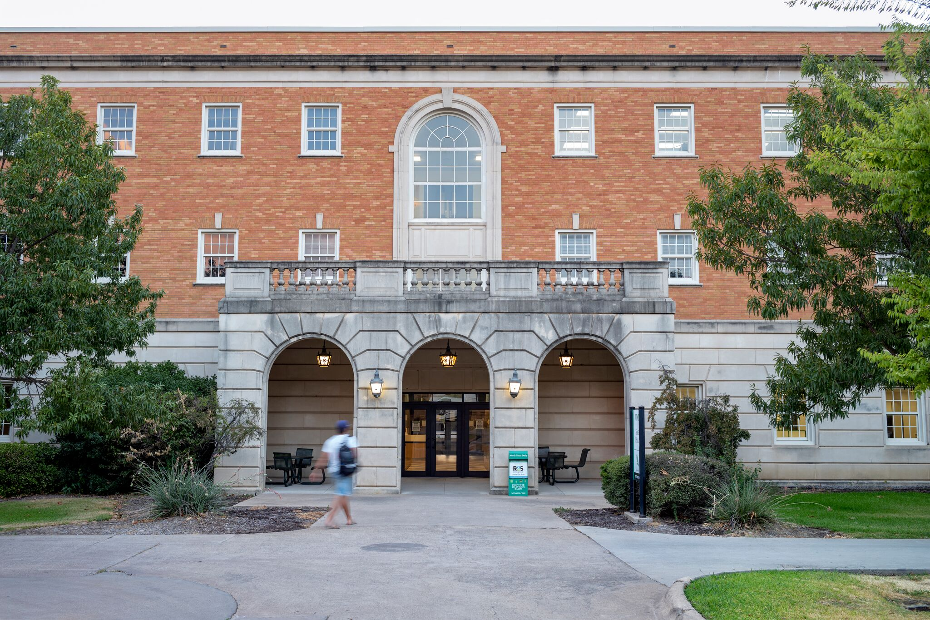

Slide 25
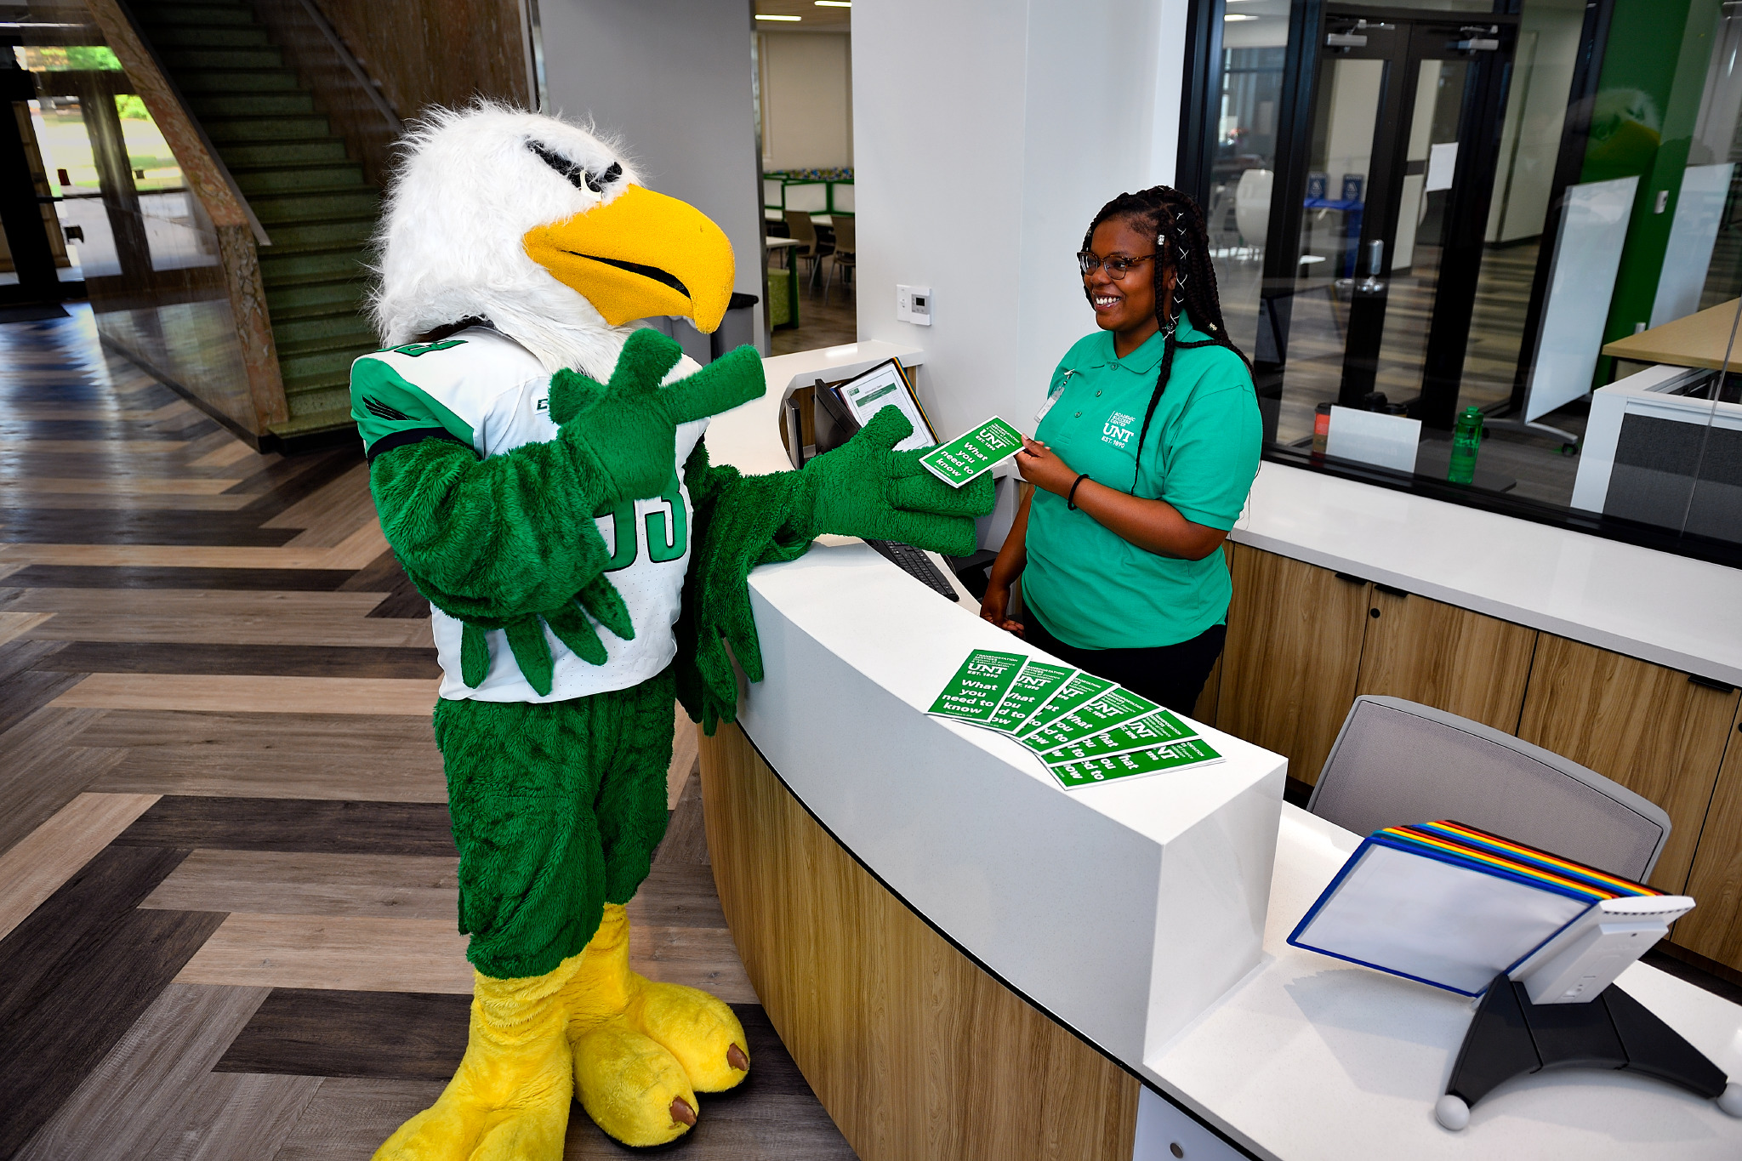

Slide 26
Academic Success Center at Sage Hall
Academic Advising Services (Sage 110 G&P)
DoS Intervention Services (Sage 110 A-C)
The Learning Center (Sage 170)
The Math Lab (Sage 130)
The Office of Disability Access (Sage 167)
Strategic Retention Initiatives (Sage 110 H&Q)
The Writing Center (Sage 150)
http://succeed.unt.edu/asc

Slide 27
Thank You!

Slide 28
Guiding Students to Appropriate Resources
Kevin is struggling in your prerequisite/gateway course that is required for his major. You notice his interest in the course is slipping and he comes to you with worry for his grade. Kevin ends up admitting he is not as interested in the material as he thought he would be.
Kevin tells you he chose this major upon admission and feels he has to see it through and finish that degree.

Slide 29
Guiding Students to Appropriate Resources
Sally is a student in your class, a class that is required for her major. You notice she is really struggling and will likely not pass the course. Sally works and has a family. She is concerned about retaking the course and questioning where she will even be able to complete her degree.
She brings to your attention that she is already a junior and knows that changing her major or career path doesn’t seem like the right thing to do.

