Slide 1
Faculty
Emergency Readiness

Slide 2
UNT Police Department
UNT Police Department:
940-565-3000 or Dial “911”
Patrol
Uniformed division 24/7/365 (vehicle, bike, & foot)
Criminal Investigations
Evidence/Records
Communications
Receive, record, & distribute information 24/7/365
Crime Prevention
Outreach and Vulnerability Assessment
Accreditation (CALEA & IACLEA)

Slide 3
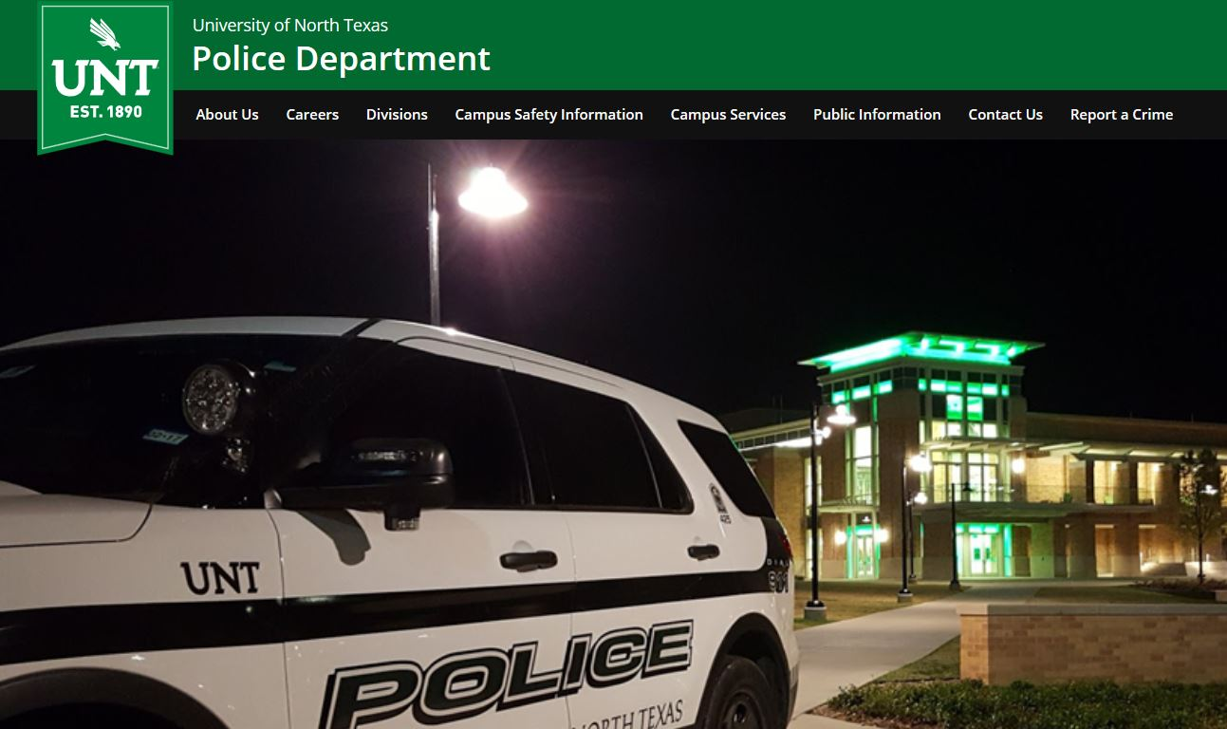
UNT Police Department Website
www.police.unt.edu
Notes:
Main thing on this slide is: 60 day crime-log under the public information

Slide 4
UNT Police Department Safety Programs
“FREE” Public Safety classes available to the community–
See www.police.unt.edu for more.
Personal and Campus Safety
How to respond to an Active Shooter
Handling a Disruptive Person
Self-Defense Training (TEST)
ID Theft Protection
Emergency Readiness
Sgt. Kevin Crawford
Kevin.Crawford@unt.edu
940-369-8984
@UNTPolice

Slide 5
Reporting Suspicious Person(s)
Specific location(s)
Type of incident
Description of person(s)/suspect(s)/vehicle
Think TOP DOWN: race/gender/clothing/other unique attributes (carrying a blue backpack, long ponytail, noticeable limp, etc.)
If no longer visible, last known location/direction headed
If safe to do so, get a license plate
Take a picture w/ cell phone from a safe distance
Remember, WE CAN’T HELP IF WE DON’T KNOW!

Slide 6
Personal Safety to Know Before Dealing with a Disruptive Individual
Have a safety plan before anything occurs and know your environment.
Trust your instincts.
Keep door open or meet in a public location if possible.
Plan and coordinate follow up meetings w/ anticipated behavior concerns:
Department Chair
Dean of Student’s Office
Police Department
GET OUT!!!

Slide 7
Handling a Disruptive Person(s) Communication
Be confident in your approach
Confidence comes from preparation and knowing why!
Make direct eye contact with the individual
Conduct yourself in a serious manner
Speak clearly and distinctively
Ensures there is no misunderstanding or confusion
Utilize your reflective listening skills
Provide options if options are available
Remember:

Slide 8
Active Shooter
If you find yourself in an Active Shooter situation:
Run – best response if you can do so safely.
Hide – if you can’t safely escape.
Fight – when your life is in immediate danger.

Slide 9
UNT Emergency Management
emergency.unt.edu

Slide 10
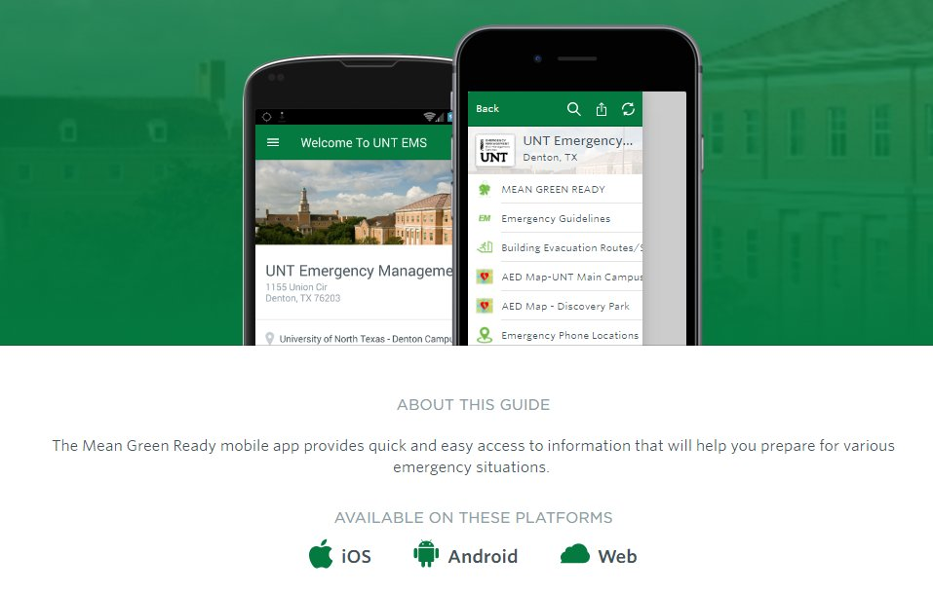
Mean Green Ready APP
In App store, Search: “UNT Emergency”

Slide 11
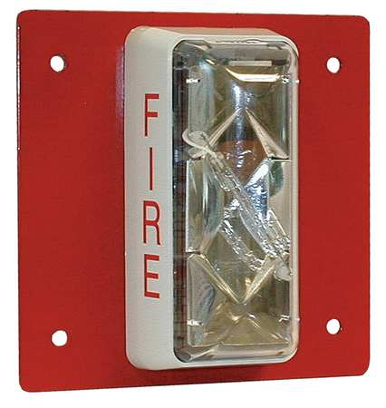
Fire Alarms and Evacuation
Never assume it’s a false alarm.
Immediately begin to evacuate the area.
Know where the closest exit is located
Identify two backup exits if possible
Inform students & others that they must evacuate immediately
Take in to account students who may have access and functional needs.
Encourage students to communicate what assistance they may need

Slide 12
Weather Related Emergencies
Tornado Sheltering:
Best location to shelter during a tornado is below ground.
If underground shelter is not available, seek shelter on the lowest level of the building.
Put as many walls between you and the exterior as possible.
Stay away from windows and exterior walls.
Where do you shelter if you hear the sirens?
Is your office / area a tornado shelter?
For more information about building specific shelters please visit:
http://emergency.unt.edu

Slide 13
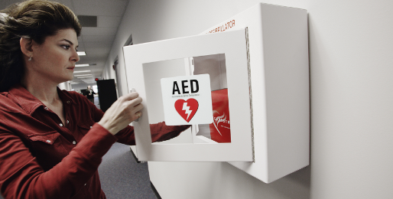
Medical Emergencies
Call 911 immediately!
If you do not have phone solicit someone else in the room
Important you know and communicate your exact location.
Sage Hall, room # 210
Designate someone to meet First Responders at main door to escort to patient’s location.
Know locations of Automated External Defibrillator (AED) for heart attack victims.

Slide 14
Alert/Notifications
Outdoor Warning Sirens:
Tested every first Wednesday of the month at noon.
NOAA Weather Radio
Always have multiple means of being notified.
Eagle Alert
Admin Announcements / Email
UNT Website / Social Media
Code Red

