Slide 1
Graduate Student ePAR Transactions

Slide 2
Agenda
Academic Session Payroll Dates
Salaried Graduate Positions (positions that begin with “A”)
Creating new positions
Transferring positions between departments or colleges
Hiring in Graduate Students in Positions
Hiring Graduate Students on an Appointment
Returning Graduate Students on a Position or Appointment
Graduate Student Terminations
General ePAR’s
Employee changes (eg funding, job code supervisor changes)
Placing a position in suspense
Ending positions
Helpful Hints and Information

Slide 3
Academic Session Payroll Dates
Academic Session | Effective Payroll Dates | FTE (for 3 semester credit hours)* | Equivalent Hours per Week *
Fall | 9/1-1/15 | 25% | 10
Fall 8W1 (8week 1) | 9/1-10/31 | 50% | 20
Fall 8W2 (8week 2) | 11/1-12/31 | 50% | 20
Winter Session | **TBD see note below | 50% | 20
Spring | 1/16-5/31 | 25% | 10
Spring 8W1 (8 week 1) | 1/16-3/31 | 50% | 20
Spring 8W2 (8 week 2) | 4/1-5/31 | 50% | 20
Summer 3W1 (3week 1) | 6/1-7/15 | 50% | 20
Summer 8W1 (8 week 1) | 6/1-7/15 | 50% | 20
SUM (summer) | 6/1-8/31 | 25% | 10
Summer 5W1 (5 week 1) | 6/1-7/15 | 50% | 20
Summer 10W (10week 1) | 6/1-8/31 | 25% | 10
Summer 5W2 (5 week 2) | 7/16-8/31 | 50% | 20
Summer 8W2 (8 week 2) | 7/16-8/31 | 50% | 20
*Prorate FTE for courses that are larger or smaller than 3 semester credit hours.
**Dates will vary from year to year. Watch for annual instructions from Academic Resources.

Slide 4
Graduate Student ePAR Transactions

Slide 5
Creating new salaried graduate student positions
Departments will need to submit an ePAR to create a new salaried graduate student position. This action is highly extraordinary and should not be done without consulting Academic Resources.
Tips for creating the e-PAR:
Type of ePAR: Vacant Position/New/Chg/End
Action: New Position-Faculty/Grad
Effective date: 9-1-XX (or other appropriate position start date)
Enter the desired job code- if unknown, use 0812 (TA Level II)
The Standard hours and FTE will default
Reports to: position number of direct supervisor
Annual Salary should be the 9 month 25% salary.
When annual salary is entered you will need to identify the source of funds.
Click the “Check this box for “A” at the beginning of the Position Nbr” box

Slide 6
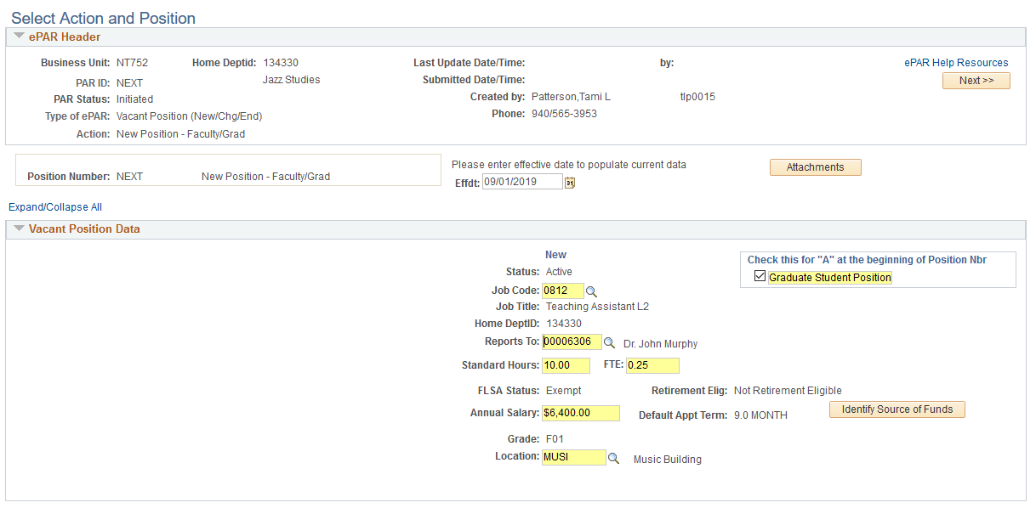

Slide 8
Transferring graduate student positions between
departments or colleges
Departments will need to submit an ePAR to transfer a salaried graduate student (beginning with “A”) position between departments or colleges. Note: The receiving department will need to initiate the ePAR.
Tips for creating the e-PAR:
Type of ePAR: Vacant Position/New/Chg/End
Action: New Transfer Position from Dept/UNTS
Enter the position number
Enter the Transfer From Department
Effective date: 9-1-XX (or other appropriate effective date)
Reports to: position number of new direct supervisor
Annual Salary should be the 9 month salary.
Do NOT Click on the “Post Job upon Final Approval” box

Slide 9
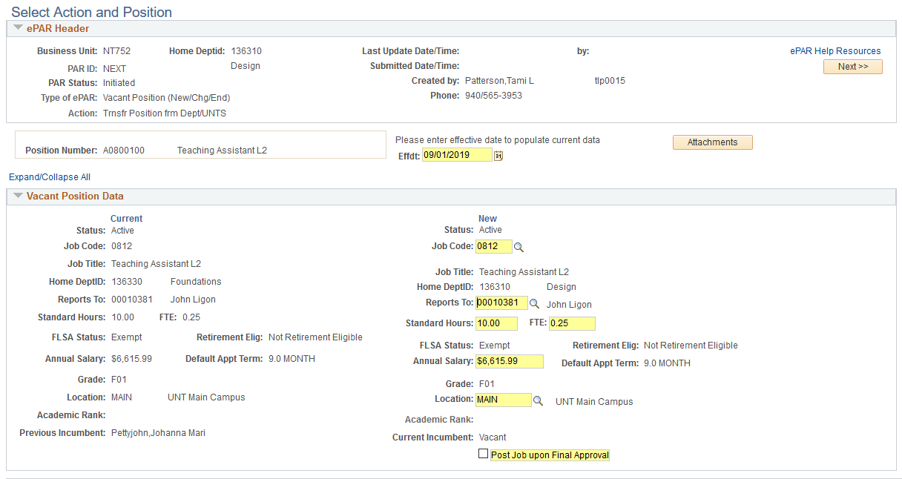
X

Slide 10
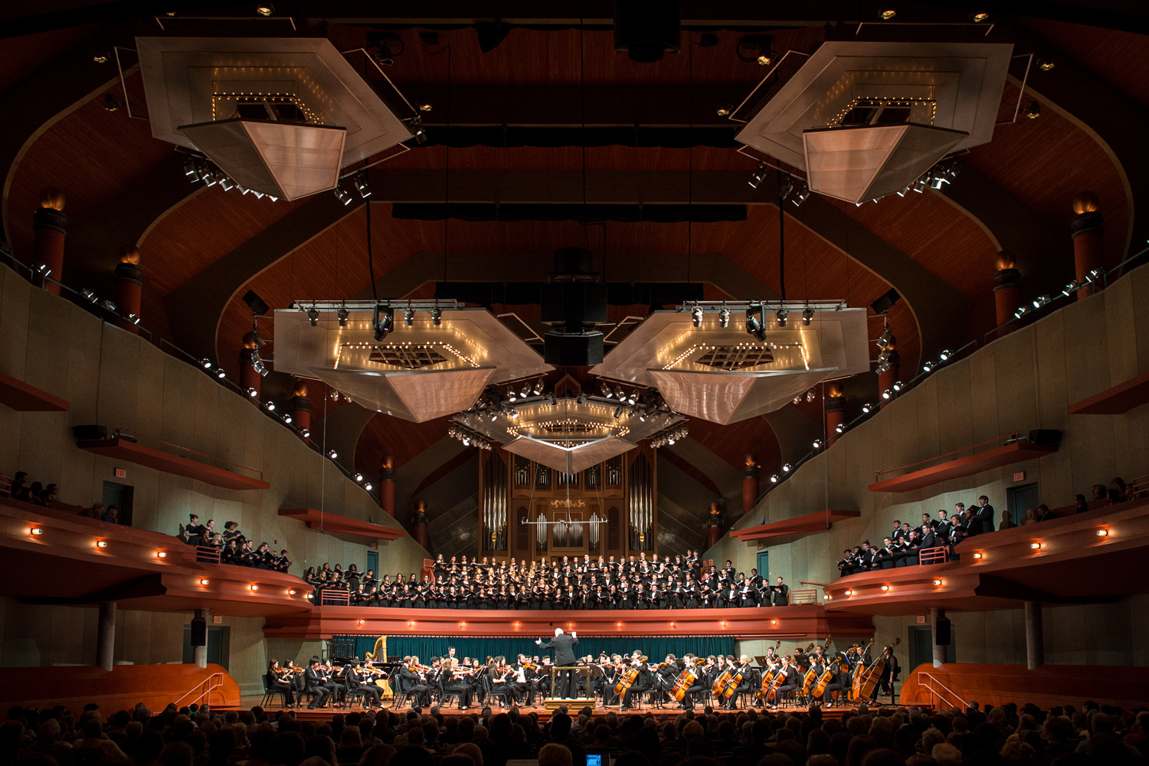
Hiring Graduate Students in Positions
If the graduate student is being hired into a budgeted position (position number Axxxxxxx), then submit via ePAR
Use the Action/Reason of Hire – Hire Salaried
Effective date – generally 9-1-XX or 1/15/XX
Enter the position number and verify that the populated data is correct.
If changes are needed click “Additional Changes Needed” and enter correct information, including updated chart string data if needed, into the yellow fields.
Budgeted positions will automatically have an end date of 5-31-XX.
Do not enter an end date in the Department Budget section of the ePAR. These positions must be encumbered for 9 months.

Slide 11
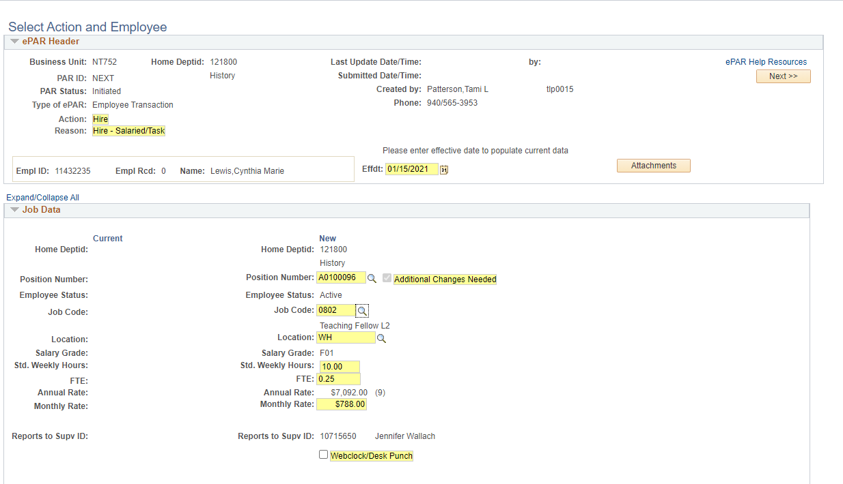

Slide 13
Hiring a Graduate Student on an Appointment
Tips for creating the e-PAR:
Type of ePAR: Employee Transaction
Action: Hire
Reason: Hire-Salaried/Task
Effective date: 9-1-XX (or other appropriate start date, e.g. 1-16-XX)
Enter the desired job code (0801-0823)
Appointment End Date: 1-15-XX (or other appropriate end date, e.g. 5-31-XX) See Academic Sessions Payroll Dates chart. Must be included in order to approve ePAR.
Reports to: Enter position number of direct supervisor
Enter the appropriate FTE
Enter the appropriate monthly rate (the annual rate will calculate as 9 months)
Enter the Employee ID number of the appropriate supervisor
Enter the appropriate chart string in the Department Budget Data section

Slide 14
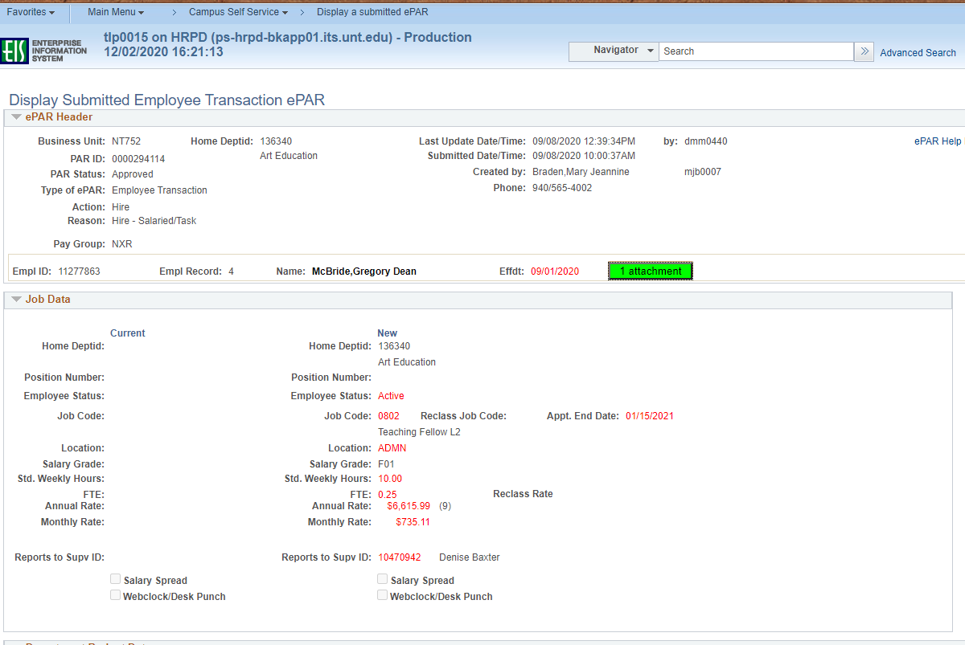
Blank

Slide 16
Returning a Graduate Student on a Position or Appointment
Tips for creating the e-PAR:
Type of ePAR: Employee Transaction
Action: Employee Change Within Department
Effective date: 9-1-XX (or other appropriate start date, eg 1-16-/XX)
For Appointments enter an Appointment End Date 1-15-XX (or other appropriate end date, e.g. 5-31-XX)
See Academic Session Payroll Dates chart for sample date information
Enter the desired job code (0801-0823)
Employee Status: Return from Work Break
Reports to: position number of direct supervisor
Enter/change FTE as needed
Enter/change the appropriate monthly rate as needed (the annual rate for appointments will calculate as 0 months (4.5 months if dates encompass 1 semester)
Enter the Employee ID number of the appropriate supervisor
Enter the appropriate chart string in the Department Budget Data section

Slide 17
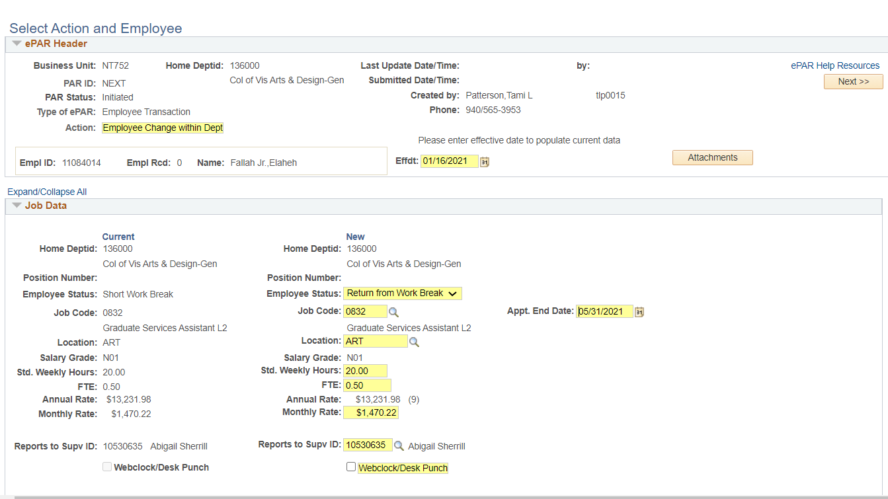

Slide 19
Graduate Student Terminations
Tips for creating the e-PAR:
Type of ePAR: Employee Transaction
Action: Termination
Reason: Select reason employee is terminating from the pull-down menu. Typically for Graduate Students this is “End of Job Assignment”.
Effective date: If a salaried graduate student is not returning, a termination can be submitted. See the Academic Session Payroll Dates slide for appropriate dates.
If a termination is not submitted, the job record will go into short workbreak status and can be terminated via the mass termination process.
If the employee does not complete the semester, a termination ePAR should be submitted with an effective date of one day after the last physical day worked.
Last Physical Date: Date employee last physically worked
Enter the appropriate number of hours worked on last physical day.

Slide 20
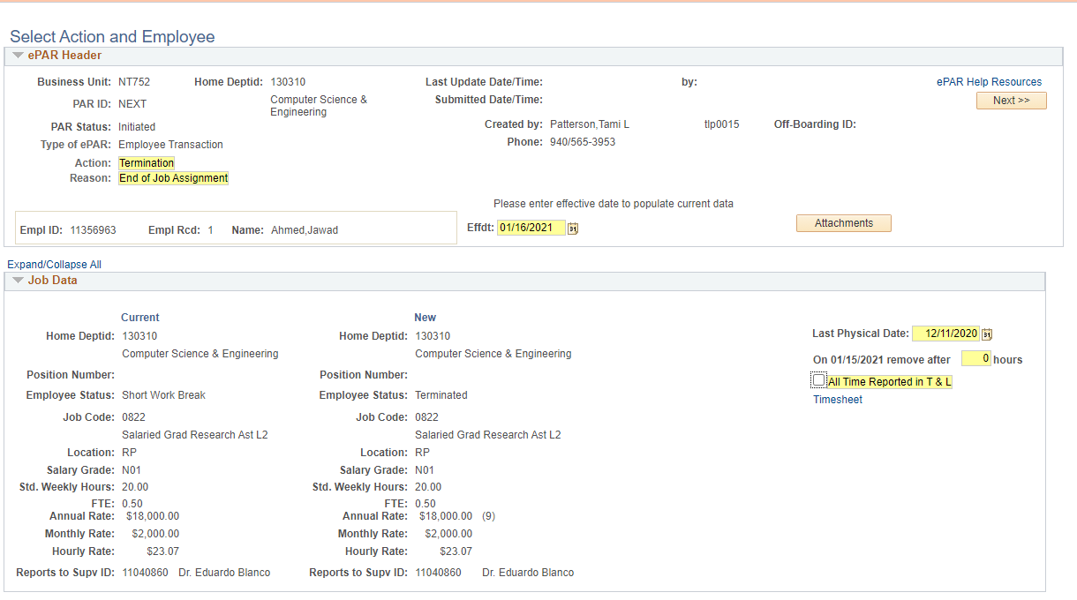

Slide 21
General ePAR Transactions

Slide 22
Employee Changes
Changes are periodically needed for both positions and appointments. Examples of needed changes include a change in the funding source, change in job code, or a supervisor change. To begin to ePAR:
Type of ePAR: Employee Transaction
Action: Employee Change Within Department
Effective date: Enter the date the change is effective
Examples follow

Slide 23
To adjust a funding source, add a new row in the Department Budget Data section by clicking on the + and entering the desired chart string

Slide 24
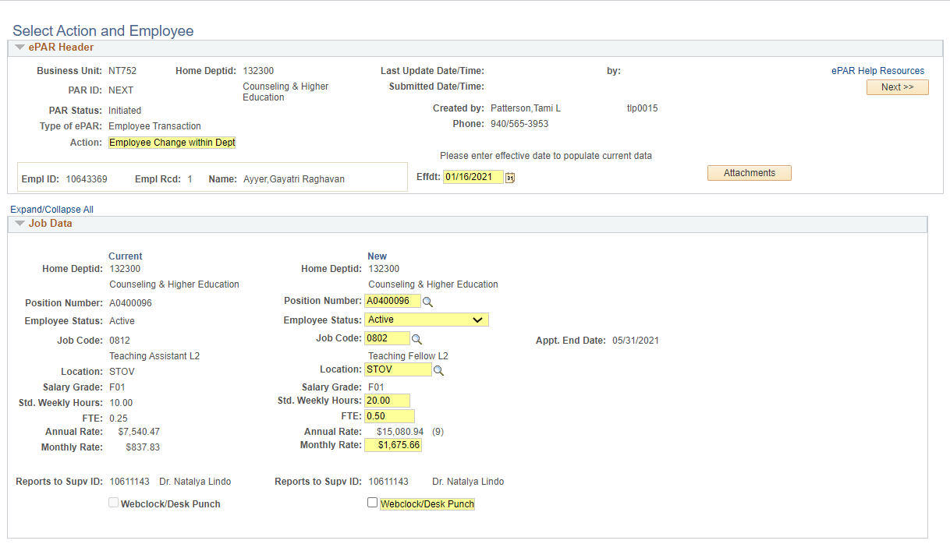
To adjust the job code, due to a change in assignment or level (levels change ONLY in fall) or FTE, enter the information as shown below

Slide 25
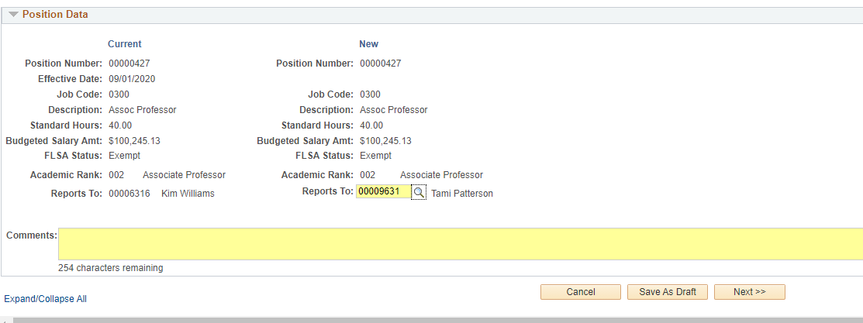
To change a supervisor, the position number of the new supervisor should be entered into the Position Data section located toward the bottom of the ePAR.

Slide 26
Placing positions in suspense
Departments will need to submit an ePAR to place a vacant position in suspense. This is rarely used for graduate student positions.
Tips for creating the e-PAR:
Type of ePAR: Vacant Position/New/Chg/End
Action: Change Position Details (temp)
Enter the position number
Enter the effective date
Add an end date to each row of funding in the Department Budget Data section

Slide 27
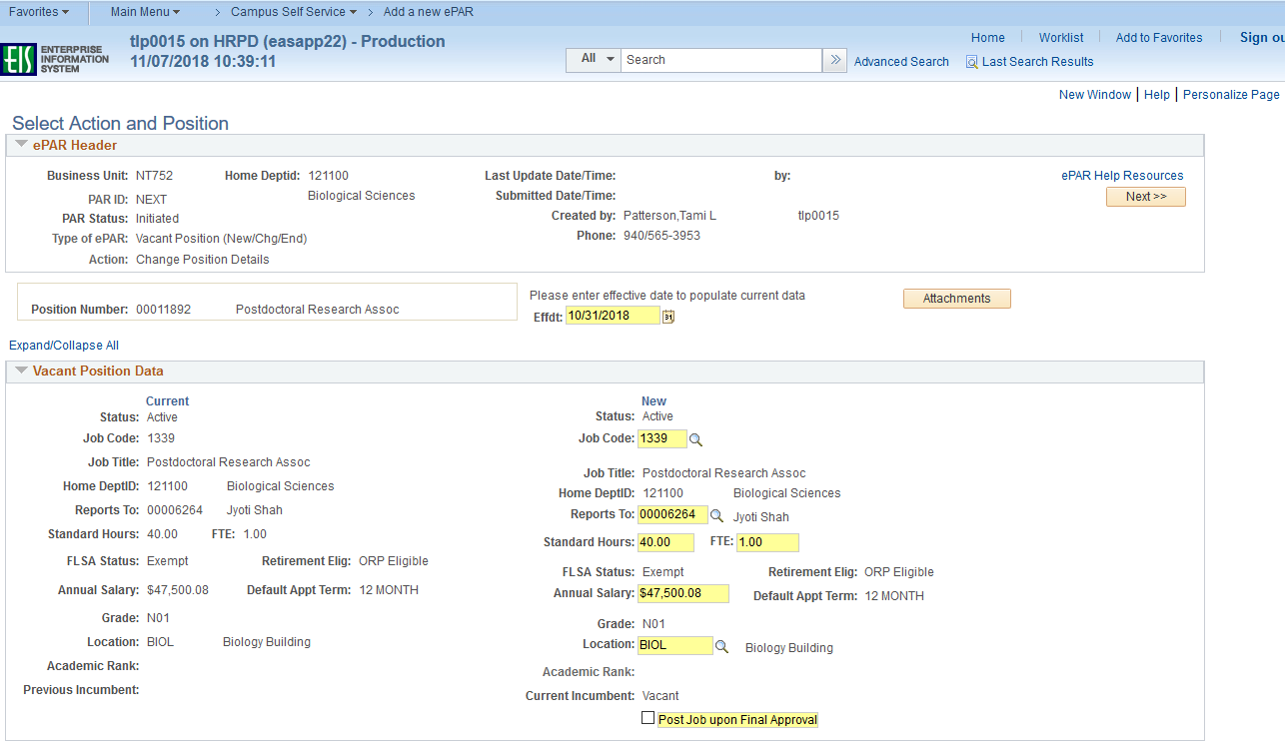

Slide 29
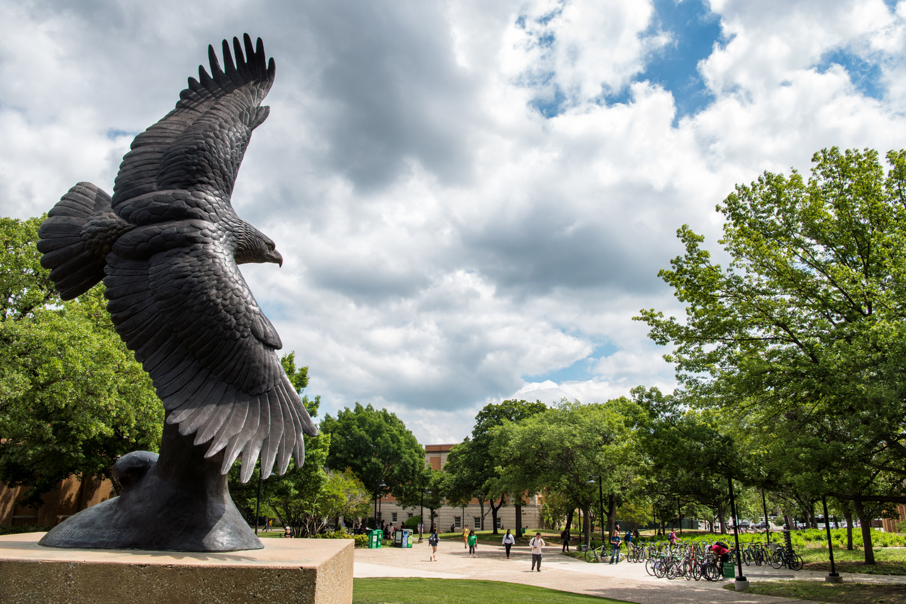
Ending Positions
Departments will need to submit an ePAR to end a faculty or salaried graduate student position. Please consult with Academic Resources before ending a position.
Tips for creating the e-PAR:
Type of ePAR: Vacant Position/New/Chg/End
Action: End Position (permanent)
Enter the position number
Effective date: 9-1-XX
Enter comments explaining the reason for ending the position.

Slide 30
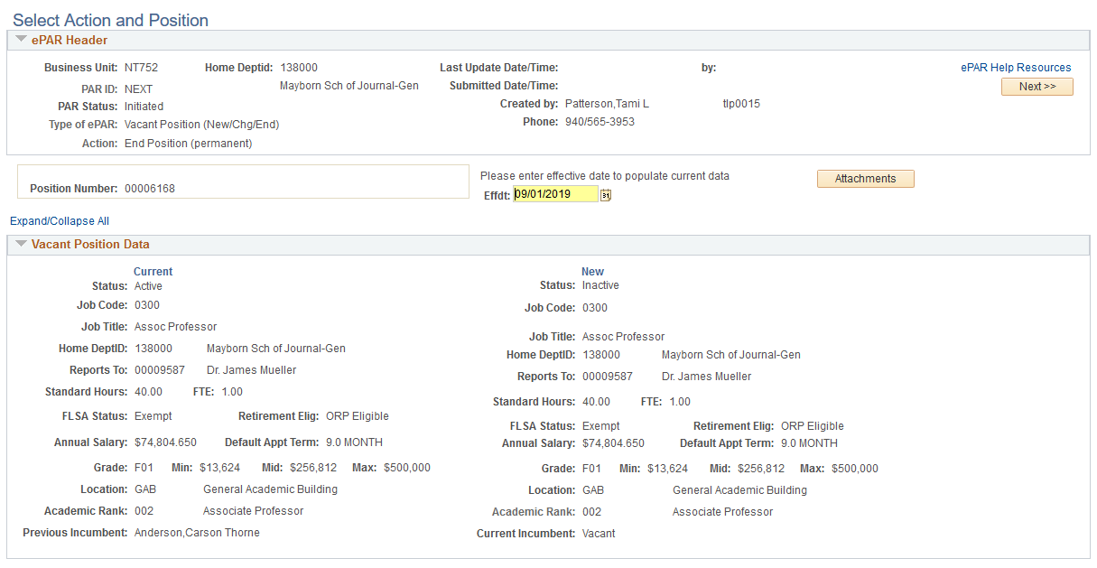

Slide 31
Helpful Hints and Information

Slide 32
Helpful Hints
Remember - Comments Are Your Friend!! Please describe the action(s) you are taking on the ePAR. If you have notes about source of funds, please include them.
Ensure all needed attachments are included.
Check the workflows – if they look unusual, please give us a call.
All new Salaried Graduate Student positions will begin with A2XXXXXX.

Slide 33
Academic Resources Contacts
Faculty and Academic Administrators, ext. 3951
Tami Patterson
Additional Pay items, Tasks, Academic Staff, FDL and Modified Service ePAR’s, ext 3953
Ext 2673
New Faculty job postings, onboarding, and records ext. 2673
Ext 3512
Salaried Grad Student ePAR’s and Criminal History Checks, and questions, ext. 3512
Chance McMillan
Adjunct job postings, hiring and ePAR’s, ext. 2138

