Slide 1
MENTORING Grant Workshop
Michael McPherson
August 26, 2016

Slide 2
Introducing Our Award Winners

Slide 3
Gaining Institutional Knowledge
Accountability
Supporting Teaching & Research Efforts
Expenditures
Developing Networks
Record keeping
Promoting Diversity
Compliance
Outcomes------------- Budget

Slide 4
Approved Expenditure Categories Include:
Faculty Travel (covers food, hotel, air, ground transportation, conference fees)
Food & Operation: (food and operating expenses when you are on campus)
Consultant Services (writing coach, editorial service, virtual mentor)
Non-Employee Honoraria (speaker fees)
Payroll (can only be used to pay CURRENT UNT students at approved rates)
Other (as approved)

Slide 5
Accountability
The Primary Contact has ultimate responsibility for ensuring that all expenditures charged to the program are correct.
Approval of expenditures should go through normal departmental procedures.
Maintain spreadsheet with expenditures.

Slide 6
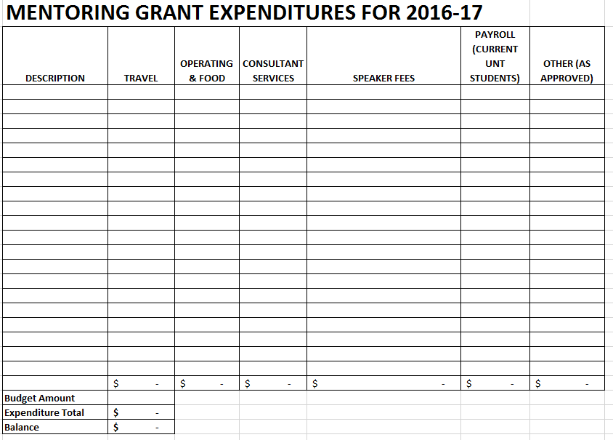
Budget Reporting

Slide 7
When in doubt, ASK your departmental assistant, chair, or dean.

Slide 8
Important Dates
Grant activities must be completed within the project beginning and ending dates
(October 1, 2016- July 31, 2017)
Promotional Material for Website
(September 16, 2016)
Mid-Year Report
(February 10, 2017)
Final Report
(October 6, 2017)

Slide 9

Leveraging Our Work
Send short paragraph of project for website by September 16th to faculty.success@unt.edu
Document, document, document
http://facultysuccess.unt.edu

Slide 10
Mid-Year Report (February 10, 2017)
Identify key challenges in achieving expected goals.
List new goals or activities based on experiences.
What specific follow-up actions do you plan to take?
One page summary submitted to faculty.success@unt.edu.

Slide 11
Final Report (October 6, 2017)
Description of Activities
Outcomes
Challenges
Budget Summary (Excel File)
Summary submitted to faculty.success@unt.edu.

Slide 12
Lessons Learned

